Slide 1
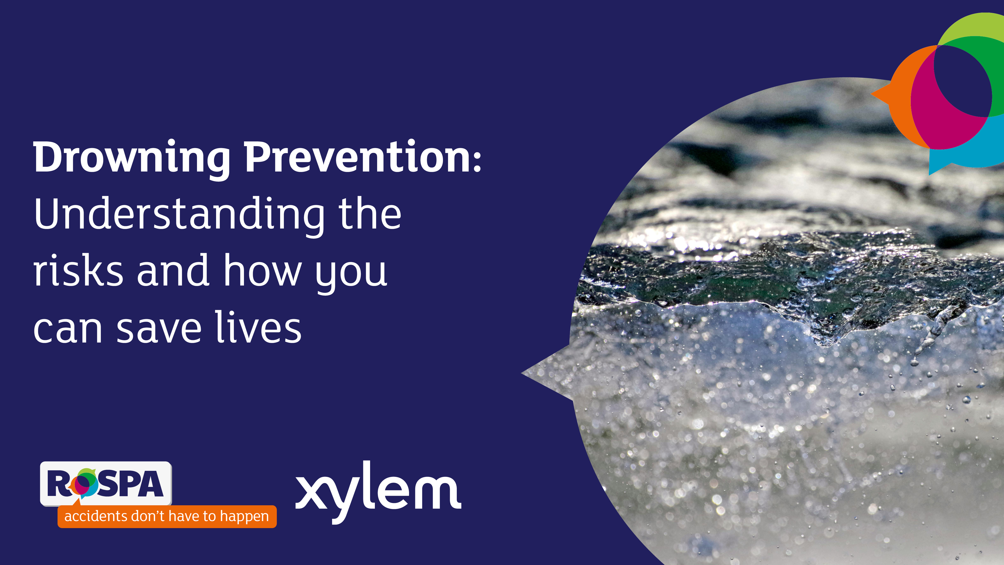

Slide 2
What is the drowning problem?
Drowning is not a small problem. Over the last decade, at least 3 million people have lost their lives to drowning.
According to the World Health Organization,
in 2021, there were 300,000 estimated drowning deaths globally, which is the equivalent to more than 30 people losing their lives to drowning every hour of every day.

Slide 3
What do we know about people who drown?
Around half of the 300,000 people were among children aged 14 years or younger.
According to the latest Global Health Estimates (2021), drowning ranks as the fourth leading cause of death among children aged 1-4
and the third leading cause among those aged 5-14.
Male drowning rates are twice that of females.

Slide 4
Number
and rate of drowning deaths by WHO region
World Health Organization. (2024) Global status report on drowning prevention 2024. Geneva: World Health Organization.
Available at: https://iris.who.int/handle/10665/379812

Slide 5
But drowning is preventable

Slide 6


Strategic priorities

Slide 7
Key topics
Supervision around water
Being safe at the coast
Alcohol awareness
Cold water shock
Find your float
World Drowning Prevention Day

Slide 8
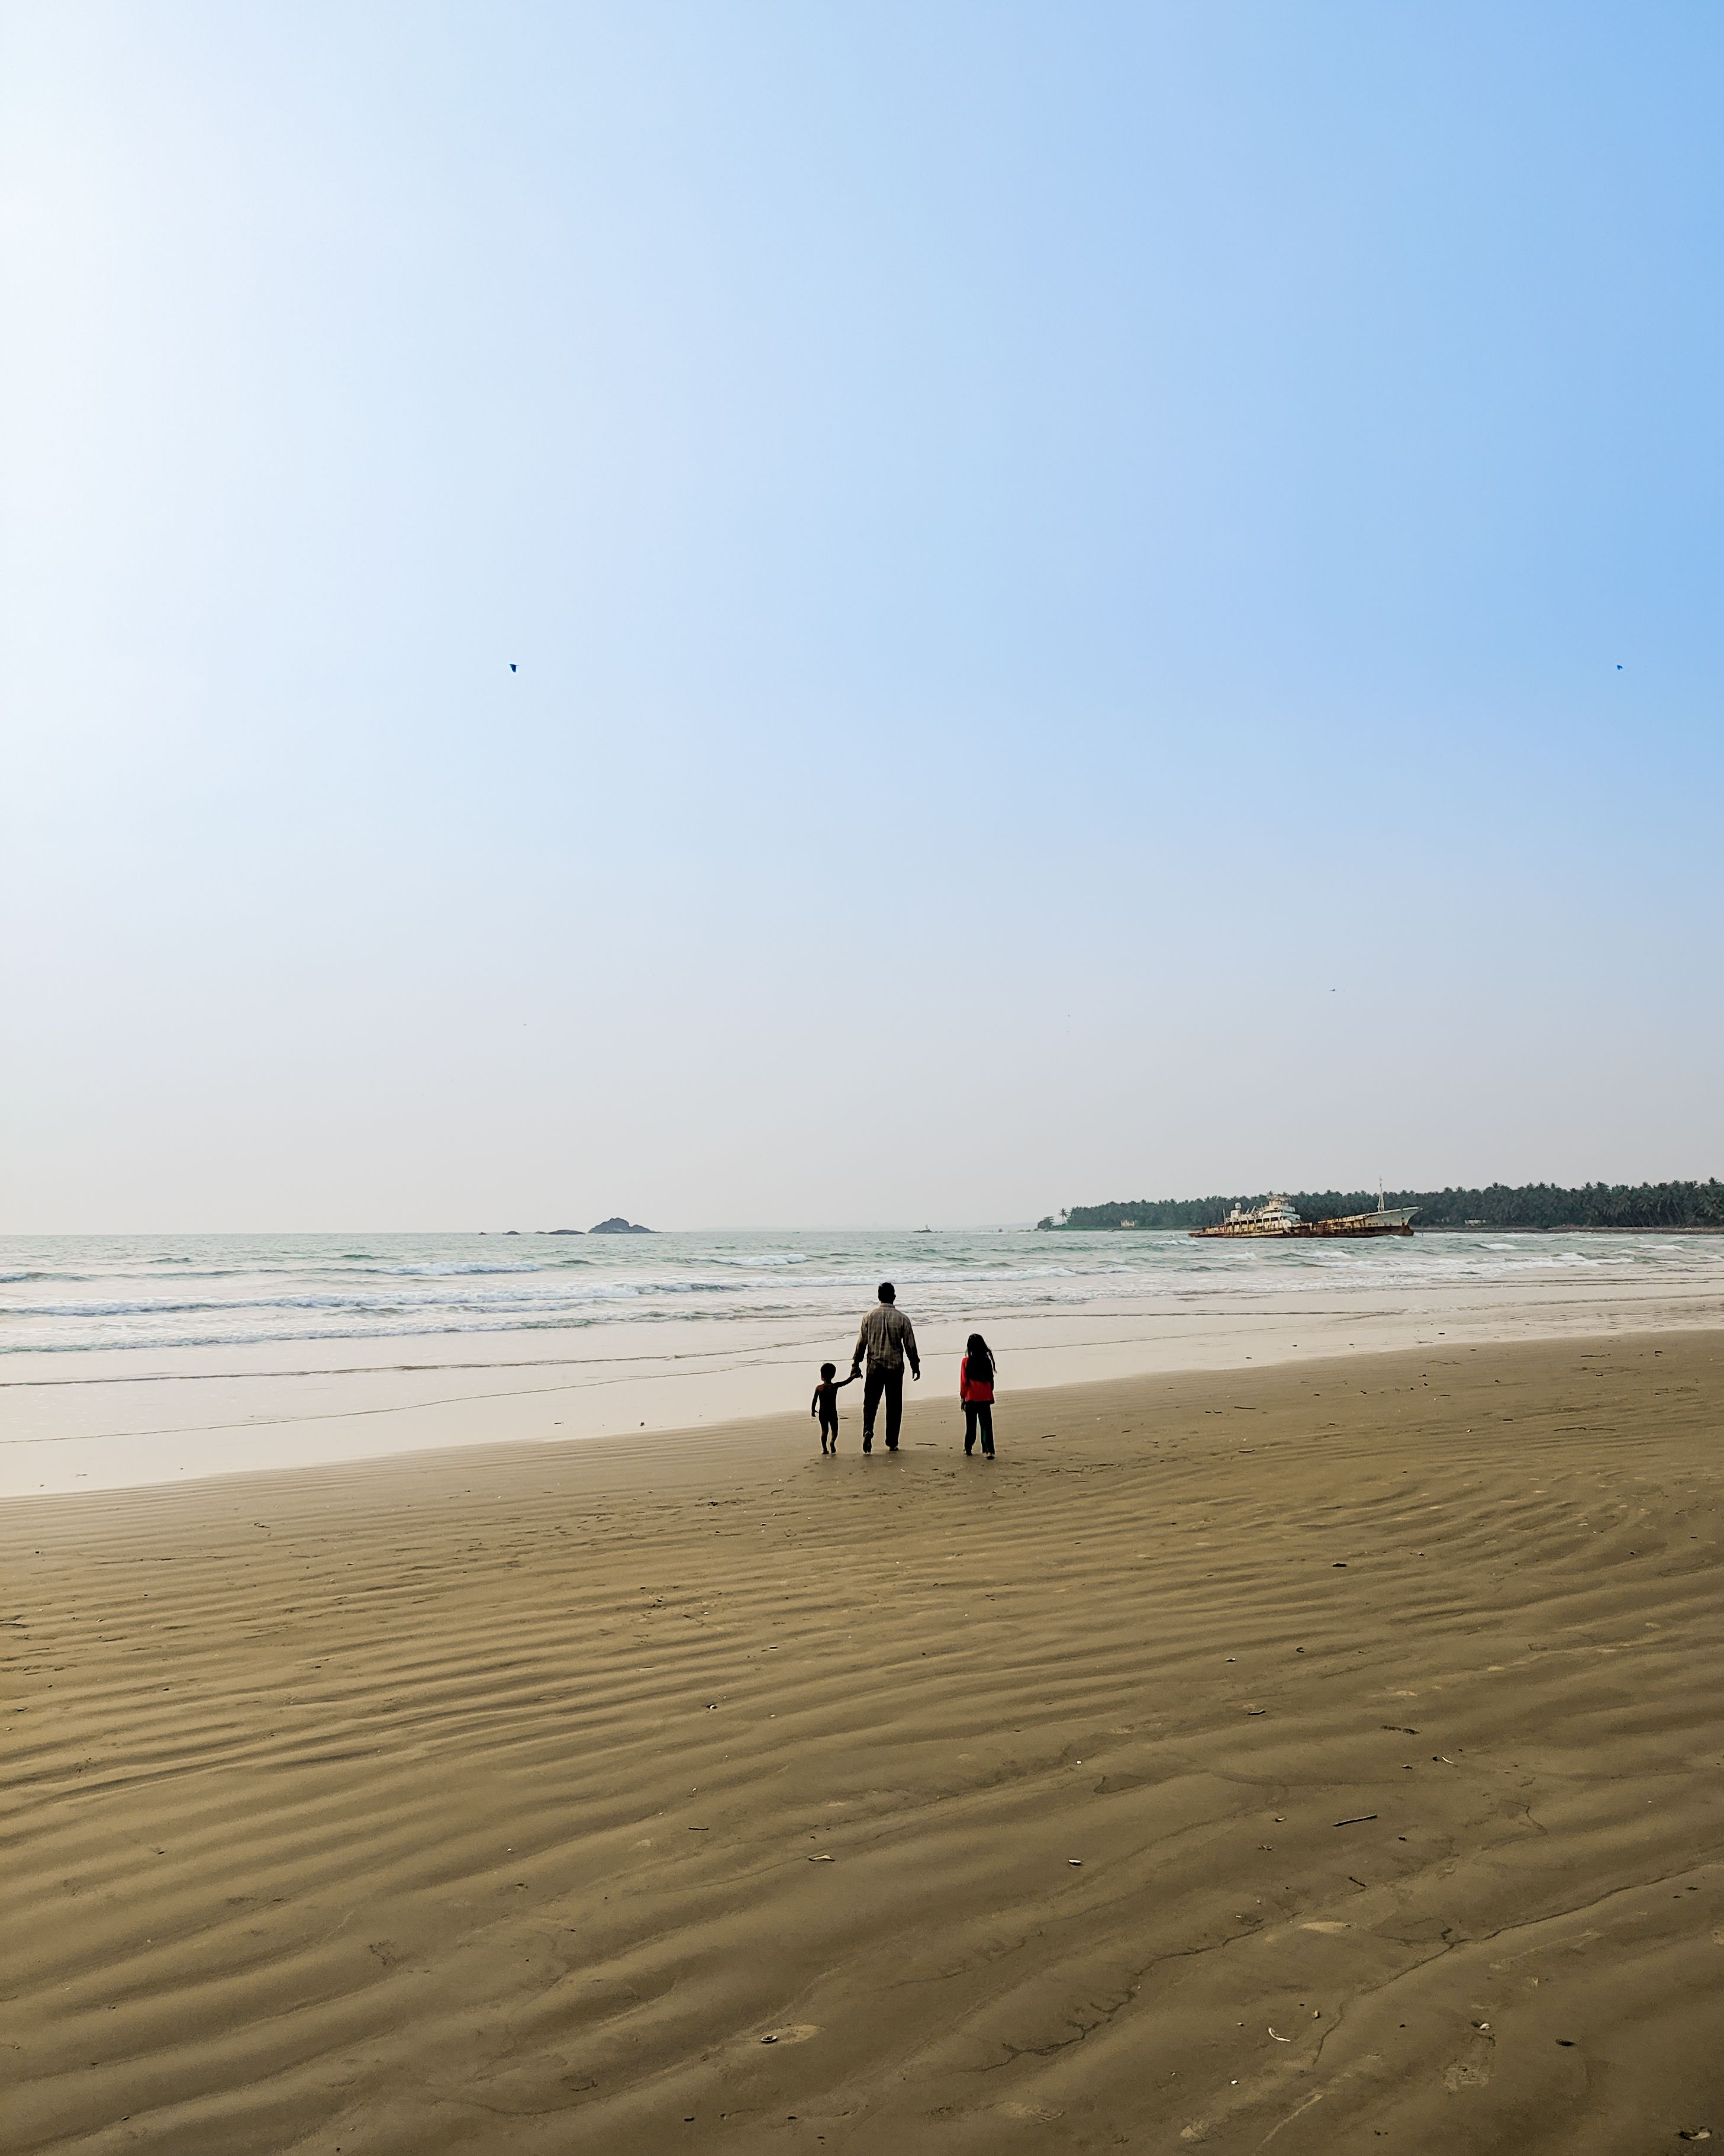
Supervision around water
According to the World Health Organization, children and young people are disproportionately affected by drowning – children under 5 years account for about a quarter of all drowning deaths globally.
There are many reasons why children are especially vulnerable – they lack risk awareness and can drown quickly without adult supervision.

Slide 9
What can we do to stay safe?
Adult supervision
Teach children
to swim
Fencing and Barriers

Slide 10
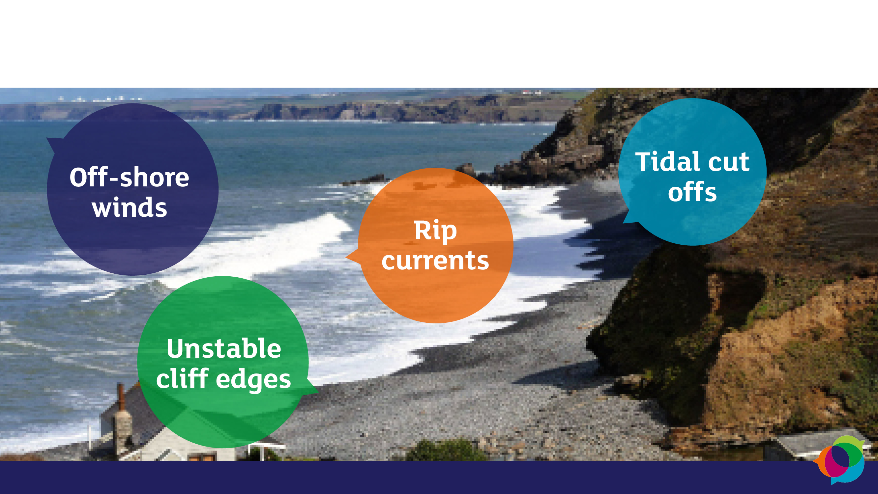
Being safe at the coast

Slide 11
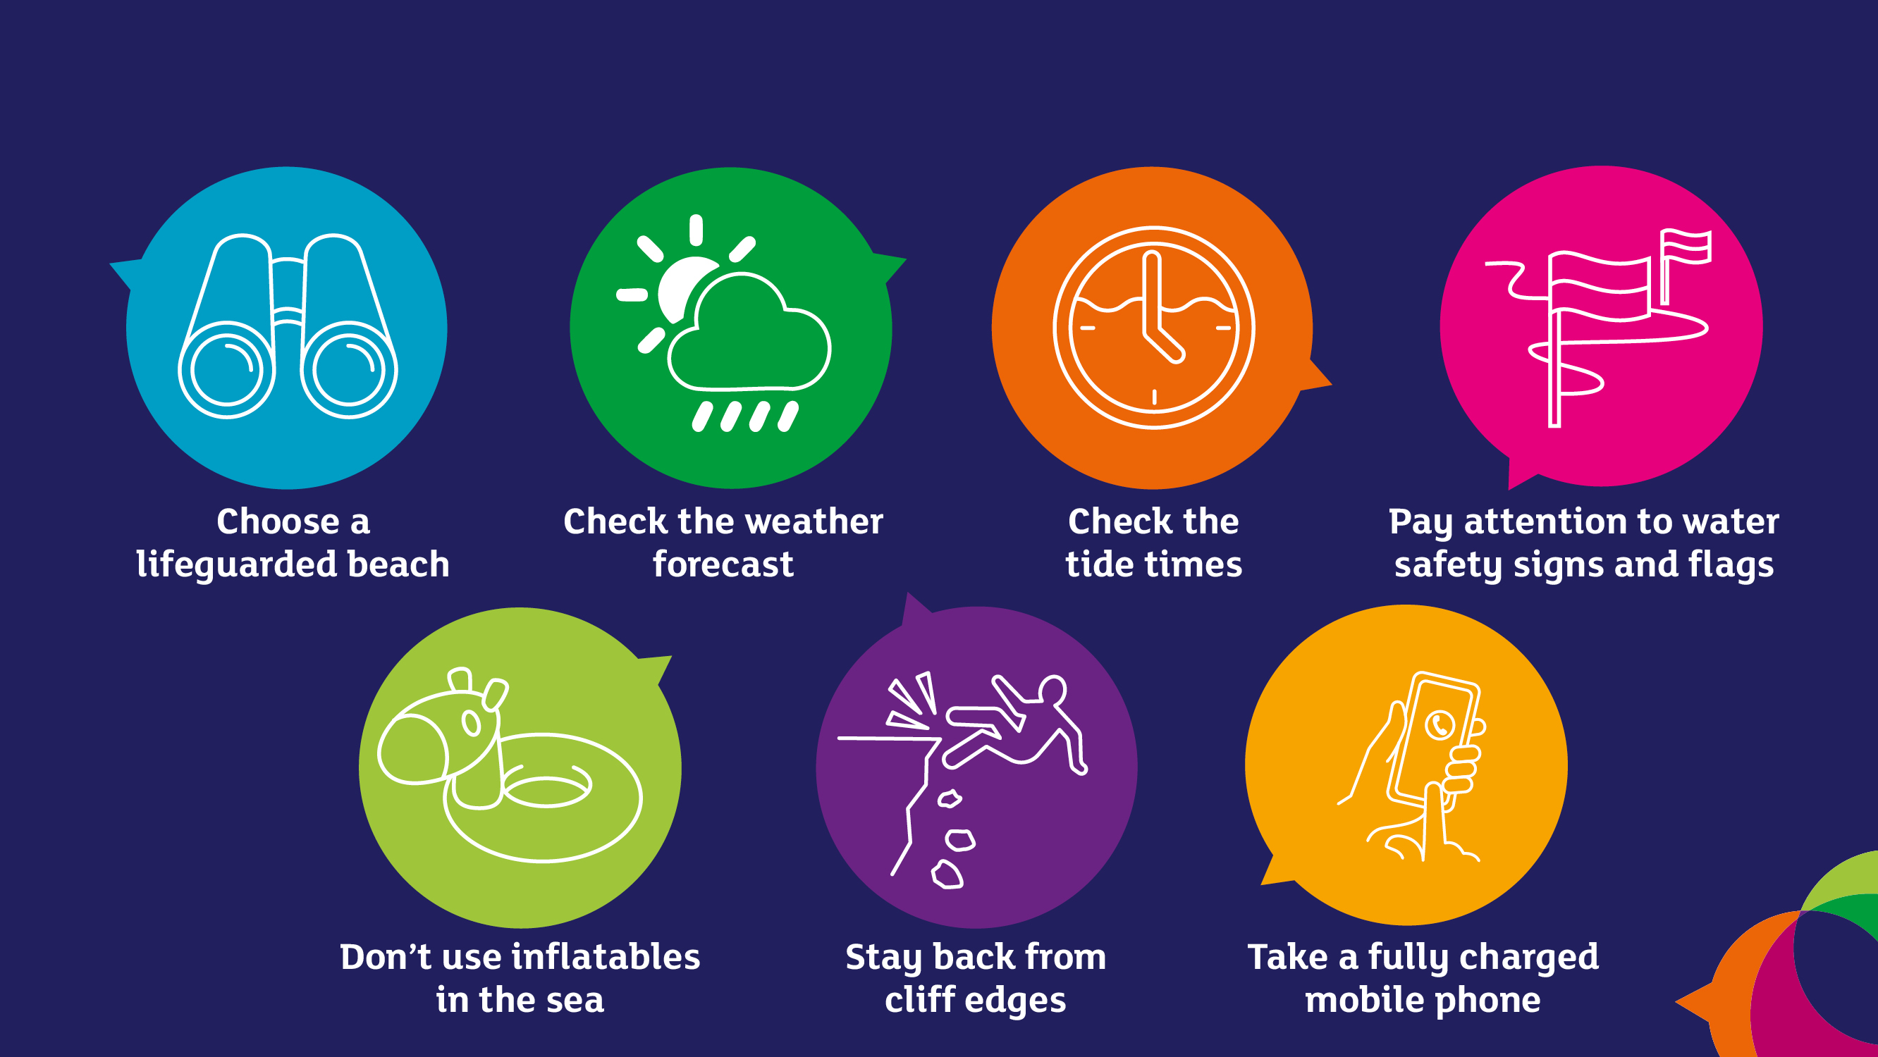
What can we do to stay safe?

Slide 12
Alcohol awareness
Many countries report alcohol consumption as contributor to drowning. It is known to increase risk of drowning for several reasons including:
It can impair judgment and decision-making which can lead people to overestimate their swimming skills and underestimate hazards
It can reduce coordination and balance, making it harder to stay afloat and swim efficiently
It slows reaction time – alcohol slows the body’s response to sudden water hazards
It can increase hypothermia vulnerability – alcohol increases heat loss in cold water and accelerates hypothermia.

Slide 13
What can we do to stay safe?
Avoid alcohol when doing a water-based activity
If you’re supervising children near waterways, avoid all alcohol.

Slide 14
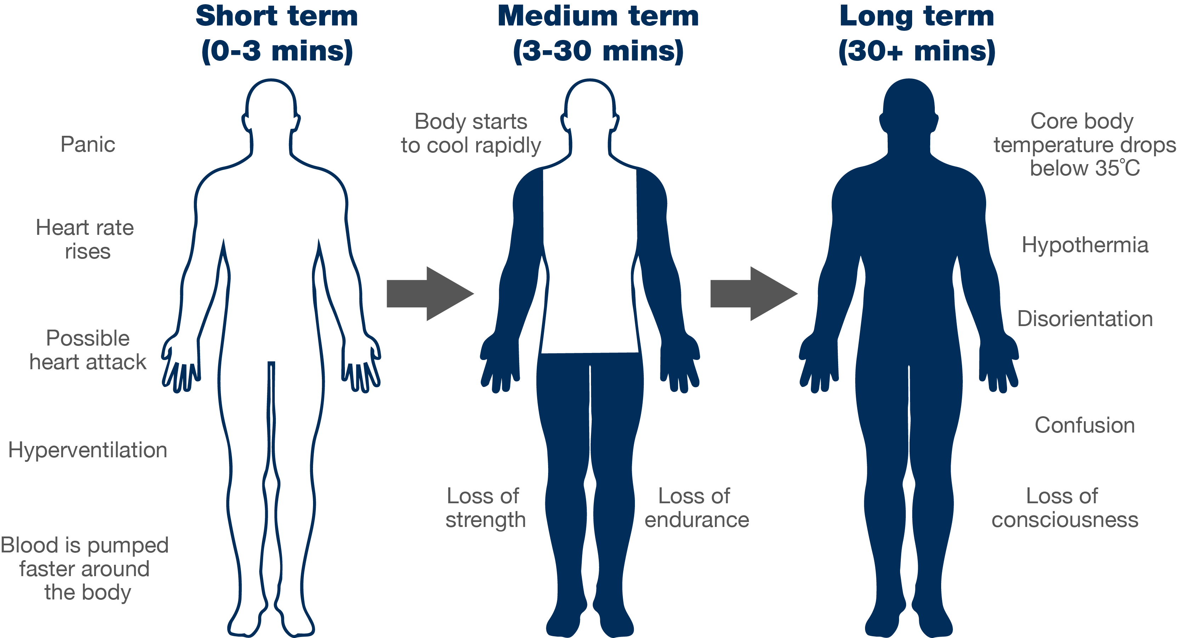
Cold water shock

Slide 15
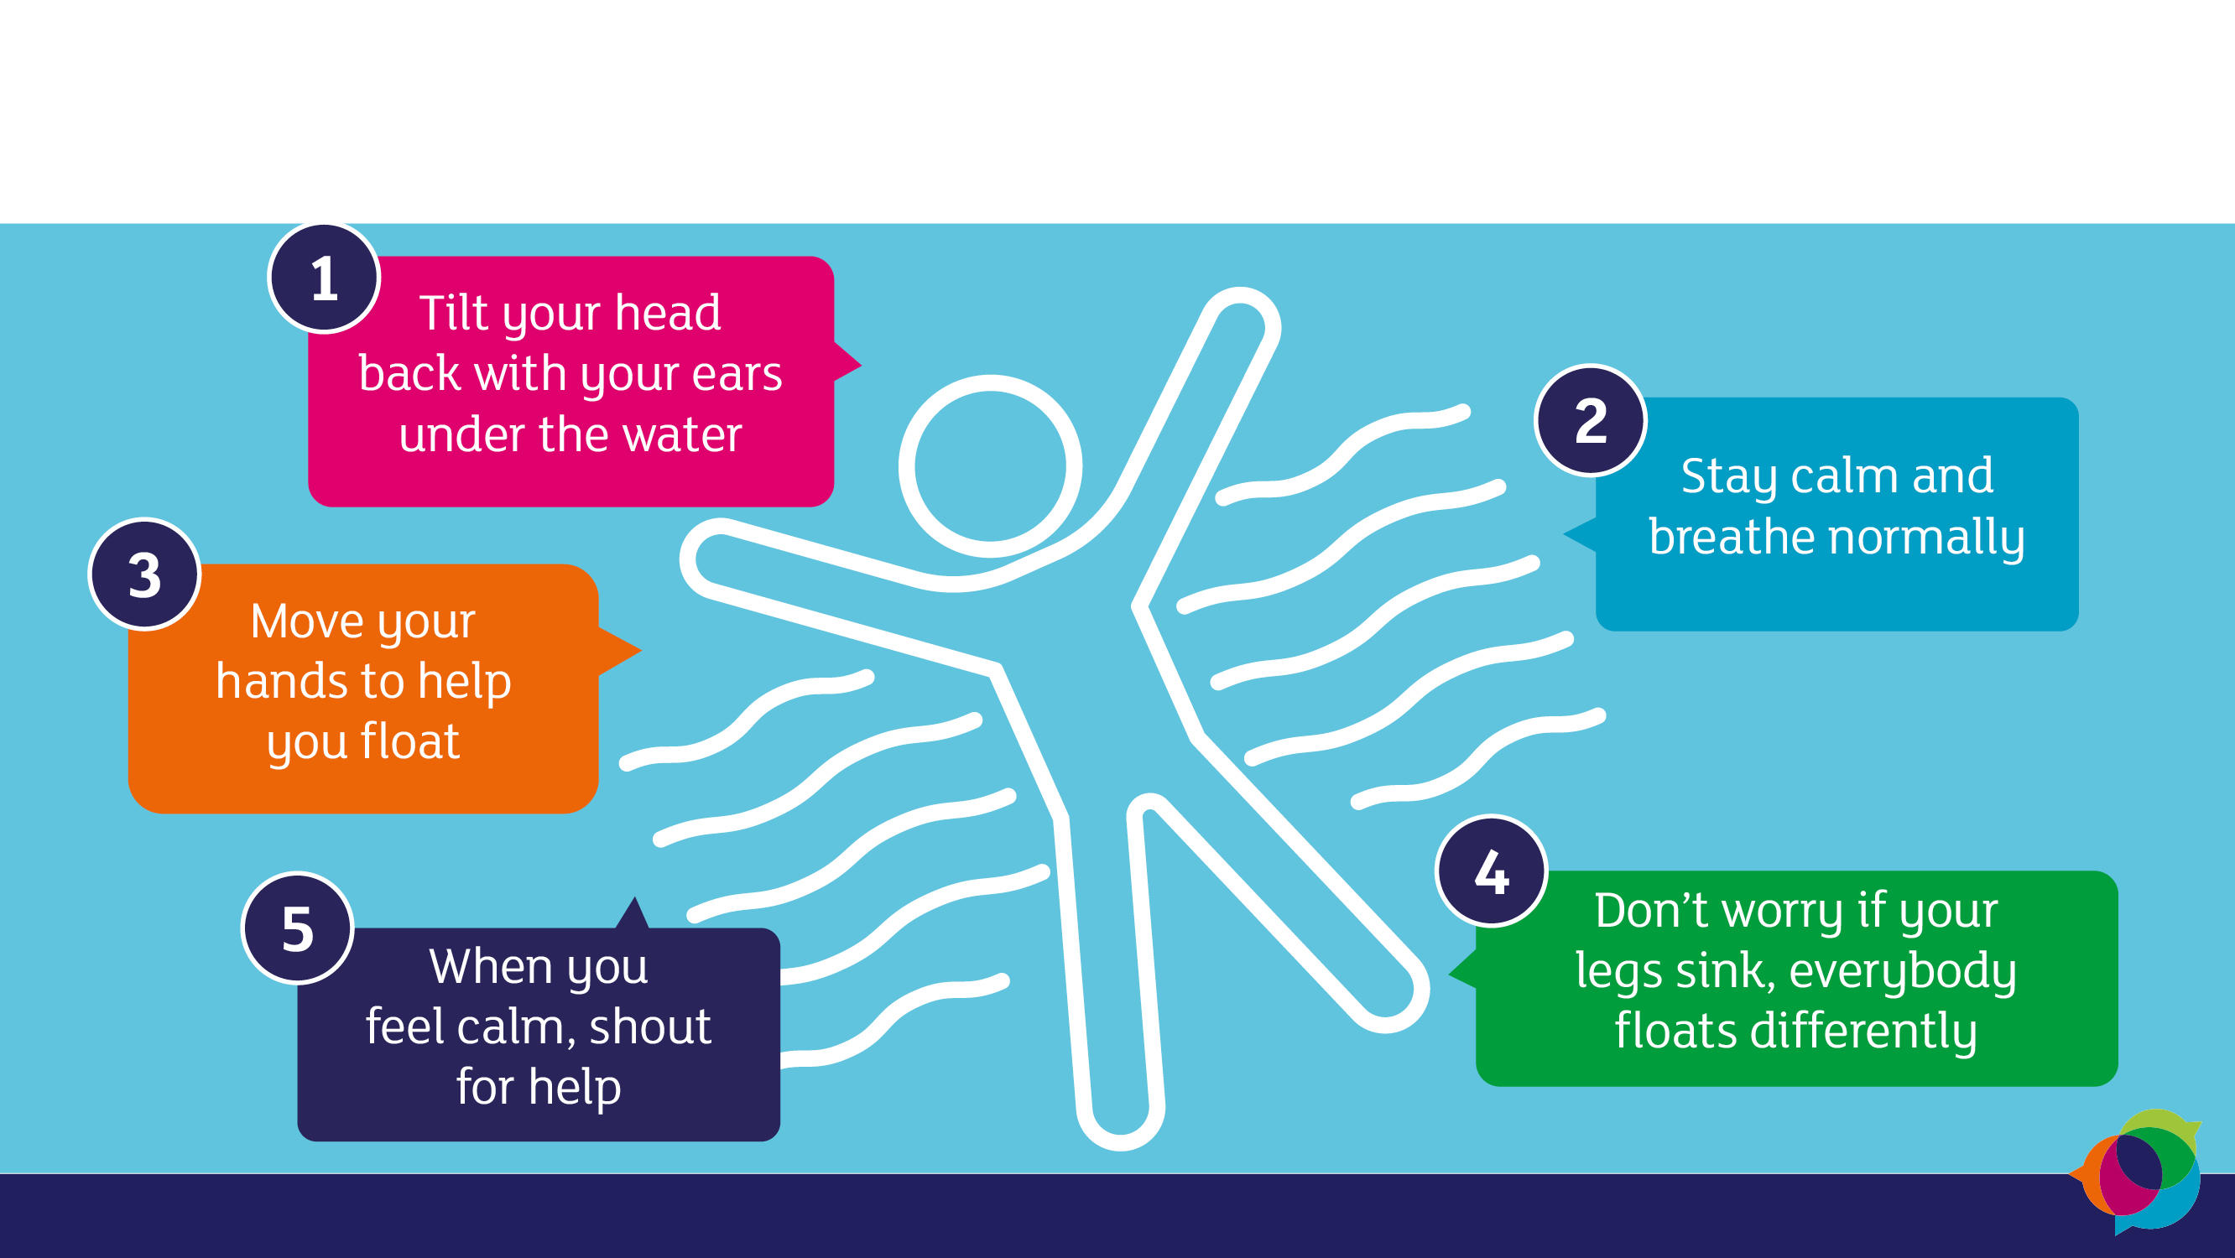
Find your float

Slide 16
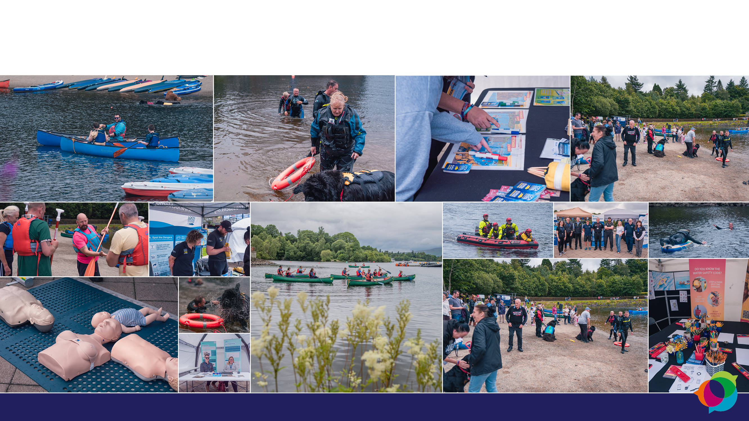
World Drowning Prevention Day

Slide 17
Resources and more information
Get involved, use the Xylem/RoSPA toolkits and family workbook
Check out more information on water safety at the following websites:
www.rospa.com/water-safety/
https://www.who.int/news-room/fact-sheets/detail/drowning

