Slide 1


What Occupational Health (& Safety) in Scotland could or should be
And why?
Andrew Watterson
1. State of Play with OHS in Scotland
2. What’s wrong – principles, policies & practices
3. A case study on Toxics Use Reduction (TUR)
4. What then should we do or can we do immediately & in the middle term?

Slide 2


STATE OF PLAY:
SOME BASIC OHS
OFFICIAL FACTS & FIGURES
FOR SCOTLAND highlights what is wrong
115,000 workers estimated to suffer work-related ill-health each year. LFS averages
Estimated c 800 cancer deaths each year and 1600 new cancer registrations each year
Estimated 53,000 new cases of work-related ill health each year with 59% stress-related
& 24% due to MSDs
Producing 302 enforcement notices served
HSE 2021/2 Business Plan “Our end-to-end approach combines strategic planning with evidenced objectives &
business insight, using blended interventions (communication, inspection & partnership activity) that focus
on enhancing end-user behaviours” & “enabling business to better manage risk for themselves”
HSE Chair August 2021 “Our resilience, flexibility and determination to deliver on our mission, values
& business plans during these testing times continues to be an inspiration”

Slide 3

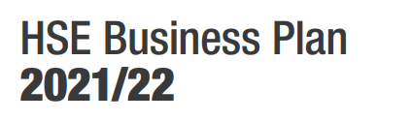

2. What’s wrong? Are our principles & related policies & practices good enough: rhetoric and reality?
“Ensure the health and safety regulatory framework remains proportionate, targeted & delivers optimal regulatory outcomes”
PRINCIPLES
- Acknowledge the benefits to health and wellbeing from a clean & harmonious work environment
The preferred approach should be to promote the principle of "prevention is better than cure“ (air pollution)
The health of every individual, especially those in vulnerable & high-risk groups, must be protected. Special attention should be paid to disadvantaged groups.
New policies, technologies & developments should be introduced with prudence & not before appropriate prior assessment of potential environmental & health impacts.
Health and Safety of individual workers should take clear precedence over considerations of economy & trade. Healthy and safe workers are productive workers in productive workplaces
Flow of chemicals/material/products/waste to be managed for optimal natural resource use & minimal contamination
Governments, public authorities and private bodies should aim at preventing & reducing adverse effects caused by potentially hazardous agents
DECENT WORK sums up the aspirations of people in their working lives. It involves opportunities for work that is productive and delivers a fair income, security in the workplace and social protection for families, better prospects for personal development and social integration, freedom for people to express their concerns, organize and participate in the decisions that affect their lives and equality of opportunity and treatment for all women and men.

Slide 4

Practices
Nation-wide problems with:
Information gathering & under-reporting of occupational ill-health & injury
Resources and staff for key agencies and workplaces – HSE & local authority ( Dr Blair has already given us detail on the occupational health professional position)
Advice & information for workforce & employers focussing on prevention & precaution
Inspection and enforcement deficit
Inter-agency/body working? HSE/LAs with PHS,HPS and SEPA. Covid exposed weaknesses (lack of OHS knowledge in public health) & strengths (positive de facto multi-agency power to address OHS issues & will & capacity to do so)

Slide 5

3. Case study of Toxics Use Reduction (TUR)
Massachusetts Toxics Use Reduction Act 1989 – 1st in USA
Goals of the Massachusetts Law:
  Achieve 50% reduction in byproduct (waste) through required company plans
  Establish toxics use reduction as the preferred means of compliance
  Promote the competitive advantage of Massachusetts Industry
  Reduce the production and use of toxic chemicals
  Between 1990 and 2016, companies in Massachusetts reduced toxic chemical use by 66%, by-product production by 72% and onsite releases by 92%.
  1400 chemicals now covered by reporting requirement but only 250 used and subject to reporting in the state. Currently 500 companies registered
  A firm must manufacture or process 25,000 pounds per year of a listed chemical, or must use 10,000 pounds per year of a listed chemical
Notes:
The program has focused on some 190 chemicals and involved over 1000 firms
5

Slide 6
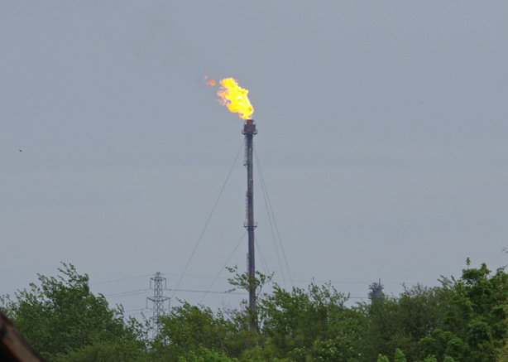
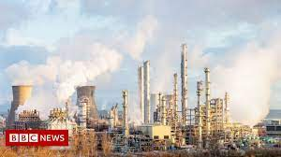
So what is toxics use reduction and why is it relevant to Scotland?
A set of tried and tested principles and practices to remove or reduce toxic substances including those damaging our climate through air, water & soil pollution & damaging worker health & safety of workers & communities producing, using or exposed to them
TUR links directly to Just Transition, Fair Work, Green Chemistry initiatives, environmental/green healthy & safe jobs, control of work and jobs, plans, sustainability and climate change with economic and health benefits to all. It also includes ways to address export of toxic substances including carbon to LMICs and
Win win win win – cuts or removes hazardous substances in work and wider environments to benefit workers, employers, communities and the environment

Slide 7


TURI Case studies
Industrial Cleaning BioBased Floor Stripping. Energy Conservation Woodworking. Paper Texas Instruments Water Conservation GKN Analog Devices - Innovative Solutions to Water Conservation. Waste Reduction Mark Richey Woodworking VOC Reduction Ophir Optics LLC - Lean Manufacturing Process Efficiency Print Works Metal Finish/Plating Trivalent Chromium Plating Conversion. Coatings Curing of Inks, Coatings. Stainless Steel Coatings, Paints, Textiles Printing Print Advertising, VOC Emissions, acid substitution with CO Life Sciences Solvent Recovery and Recycling Microbreweries Safer Cleaning and Sanitizing Technology Food and Beverage Cape Cod Potato Chips - Food Manufacturer Shrinks Chemical Use Autobody/Auto Repair Mike's Autobody - Safer Alternatives to Toxic Chemicals Miscellaneous Acushnet Rubber Company - ISO Certification through TUR.
https://www.turi.org/TURI_Publications/Case_Studies

Slide 8


4. What can and should we do now? Adopting & integrating principles, policies & practices Concepts to inform a ‘Scottish Occupational Health & Safety Agency’ approach?
Adopting WHO and ILO principles, policies and conventions especially precaution and prevention – work environment justice
Integrating agency & government departments more closely and effectively on OH policy and practice. HSE/LA/NHS/PHS/HPS/SEPA/EC/SOC/ JT - FW
Linking not losing occupational health to public health – the Covid spin-off for OHS action?
Adequately staffed and resourced HSE and local government inspectors to advise, inform and effectively enforce OHS laws if necessary. Possible now
Creating a comprehensive NHS based OH service, advocated by Scottish Hazards, possible under current powers & in Health & Work Strategy Review
Greater agency transparency & accountability on work environment & wider environment health to the particular communities they cover
Setting up worker and community health and safety centres across Scotland to advise employees
Innovative methods of workplace and community participation could be developed to harness local skills and knowledge – TUR, Citizen Science, Roving reps
SCOTLAND’s TUR Act?

