Slide 1
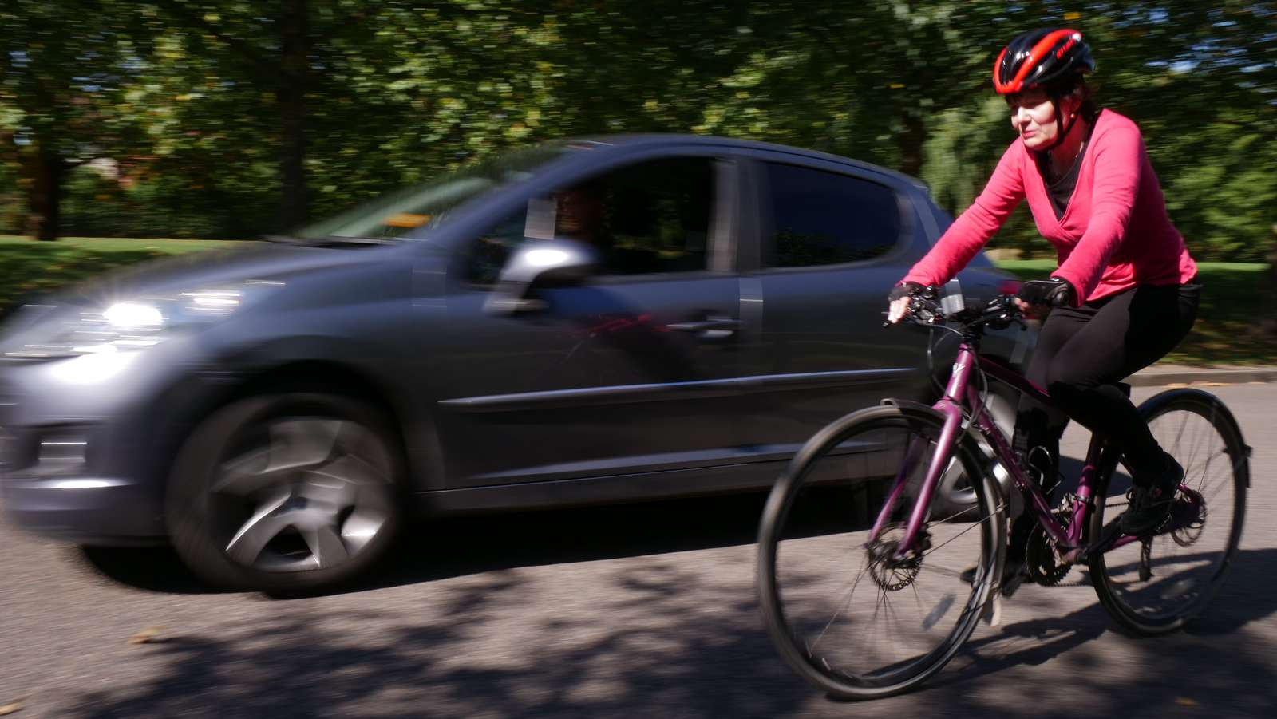






Highway Code changes
Jim Densham,
Campaigns and policy manager
Cycling UK in Scotland
t 01483 238300 e cycling@cyclinguk.org w cyclinguk.org

Slide 2

Hierarchy of road users
Campaigns
March 2022

Slide 3
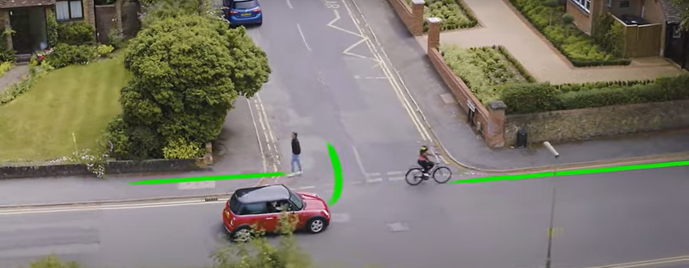
Junction priority
Campaigns
March 2022

Slide 4
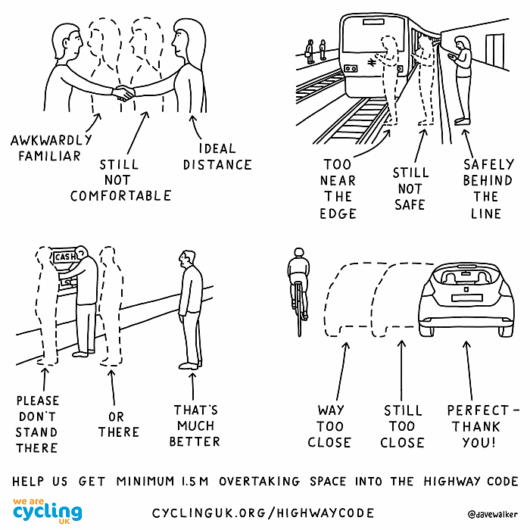
Passing distances
Campaigns
March 2022

Slide 5
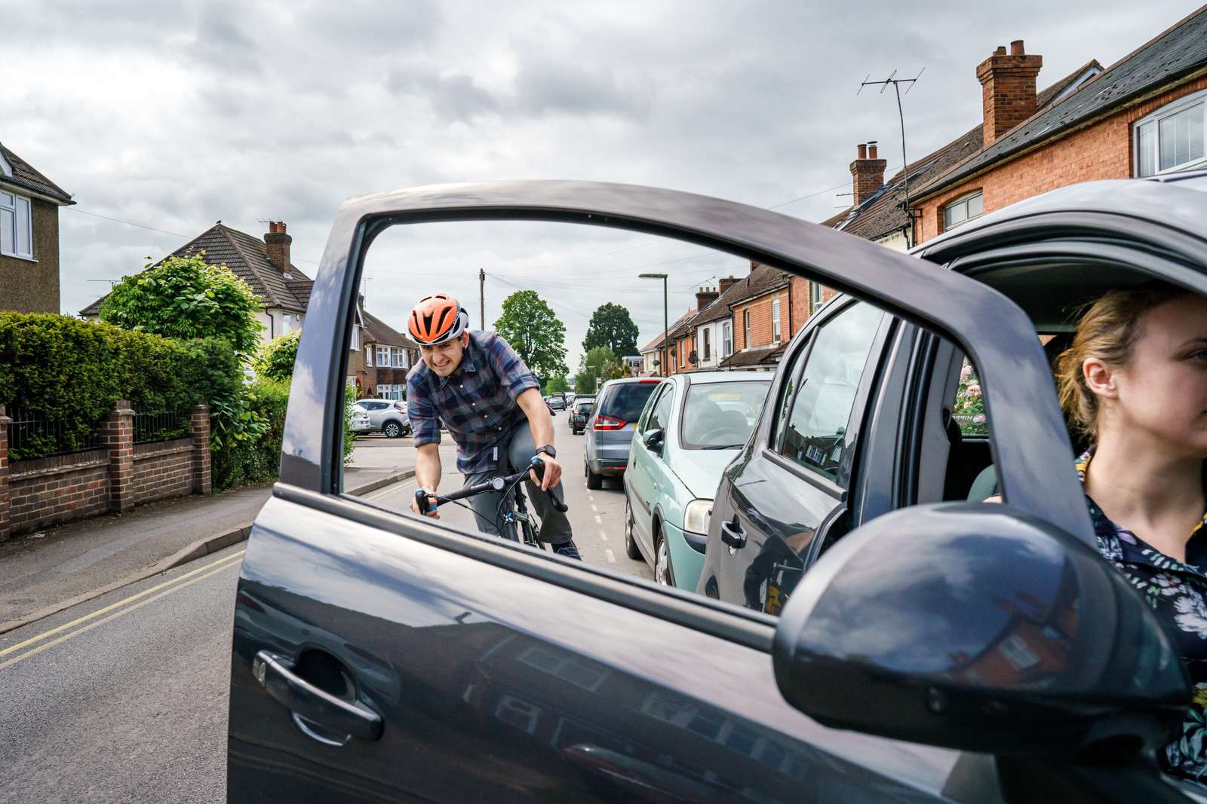
Dutch Reach
Campaigns
March 2022

Slide 6
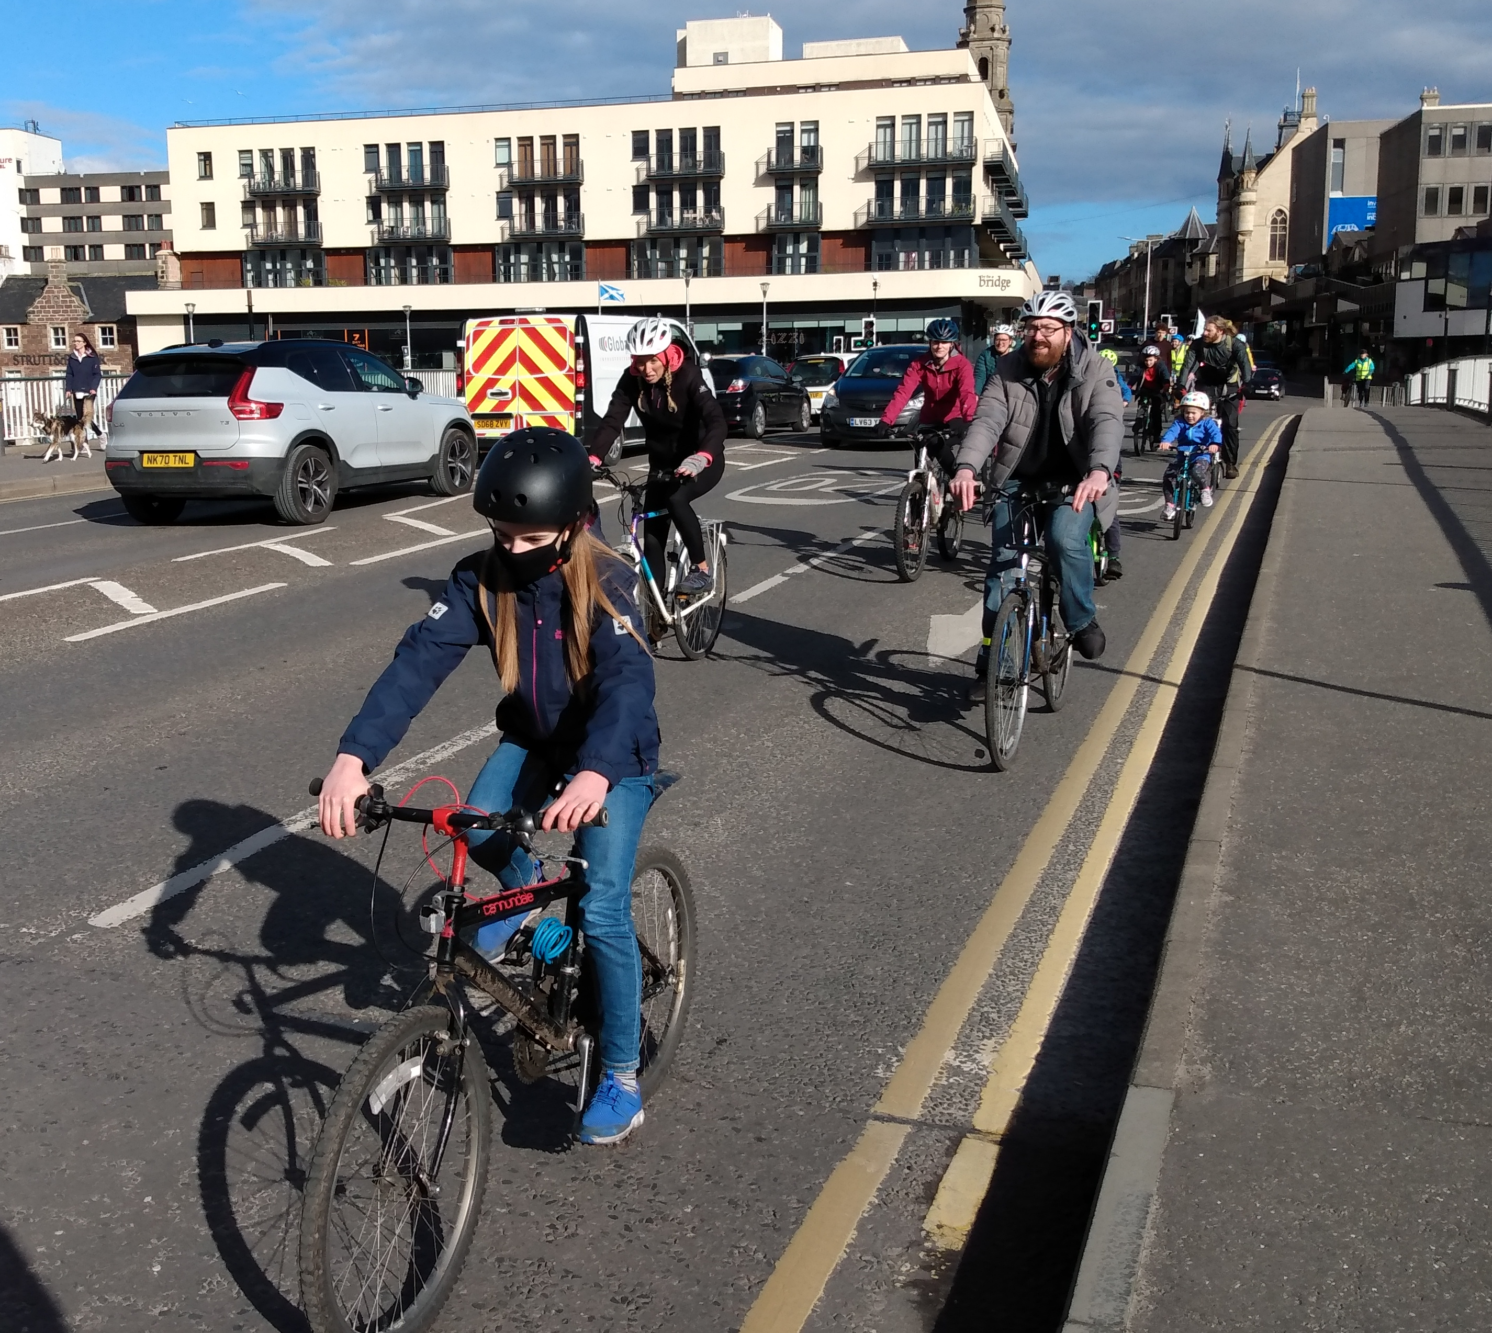
Other changes
Group riding
Road positioning
Advanced stop lines
Filtering
Roundabout priority
Campaigns
March 2022

Slide 7
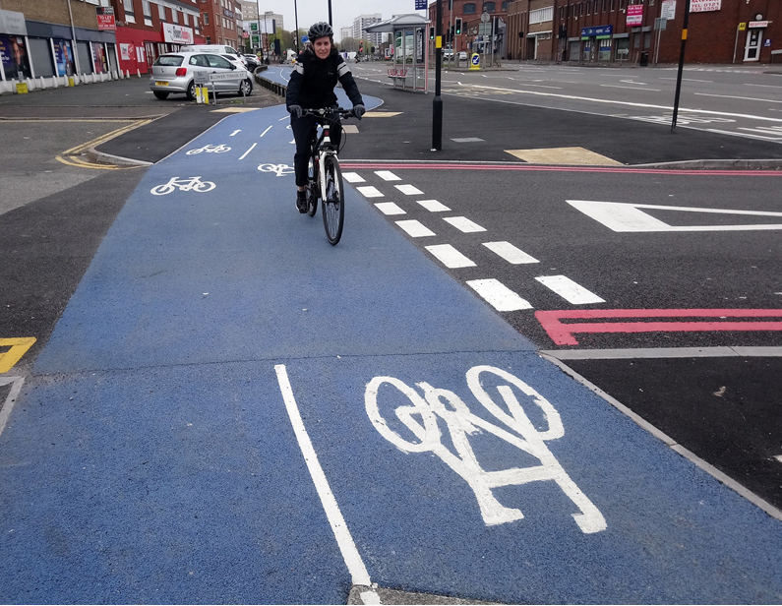


What next?
Campaigns
March 2022

Slide 8
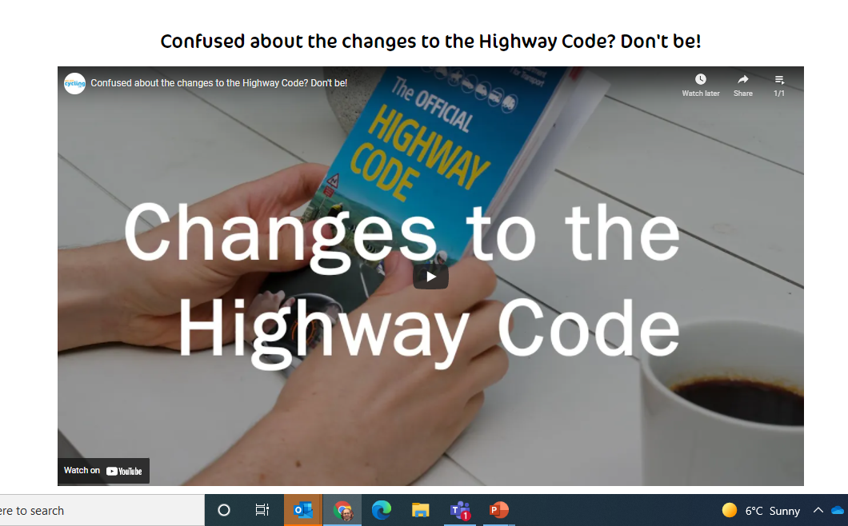
More information
Cycling UK website
www.cyclinguk.org/safer-highway-code-cyclists
Contact me
Jim.Densham@cyclinguk.org
@JimDensham
Campaigns
March 2022

