Slide 1

A presentation to Cross Party Group on Accident Prevention and Safety Awareness 1st Feb 2022
On behalf of

Slide 2
The Need for Occupational Health at Work in Scotland
Dr Sue Blair MBChB FFOM
Consultant in Occupational Medicine NHS Fife
Specialty Adviser to Chief Medical Officer
Faculty of Occupational Medicine, Scottish Convener

Slide 3
SOHAG
Prof Ewan Macdonald OBE, UoG, HWL, Chair of SOHAG
Marisa Stevenson, Academic OHN Lead, UWS
Alastair Leckie, NHS Lothian & Assoc PGD NES
Robert Atkinson, Lead Health & Work Services, PHS
Mairi Gaffney, Head of OH, NSS
Sarah Jones, HSE
Prof Drushca Lalloo, UoG & private sector OH
Oli Asatiani, Chair SOM Scotland & private sector
Sue Blair, NHS Fife & FOM & SACMO
Notes:
WHY an action group
We are a dying speciality - sounds dramatic but hopefully this presentation will illustrate why and why we feel that we have only a few years to turn things around.
SGs OH Review in 2019 – but no actoin has yet been taken
Heathly Working Lives Team pauseed and redepolyed in covid pandemic with no prospect or sense that it will be re-instated
Therefore this is effectively a withdrawal of nationally funded OH services to the Small and Medium Sized Enterprises that employ over a million workers in Scotland, meaning that even less than the current 50% of workers in Scotland that have access to OH Services will do so going forward, unless action is taken at government / strategic level
The covid pandemic has shone a light on the value and need for OH services for worker health and health protection more than ever before and going forward there is a need to strengthen these services rather than see them wither on the vine like HWL
There is an aging workforce in OH specialists both nursing and medical and a crisis in training, this needs a focus and resourced as is happening in England where there is currently a ‘Growing Occupational Health ‘ initiative with £100 millions resourcing by NHSEngland and Improvement looking at developing OH leaders, increasing training posts and pilot projects in OH service delivery
Scotland used to be the leading UK nation in worker health, but now it is lagging behind
In fact it has the lowest provision of OH in the developed world
So wjhat are we wanting to achieve as an action group?
We need a place to sit strategically
We need resourcing
We would like to see universal access to occupational health services for all Scottish Workers
We would like to see a new centre for health and Work
We would like to work in partnership to achieve our goals and bring OH services in Scotland back from the brink of extinction

Slide 4
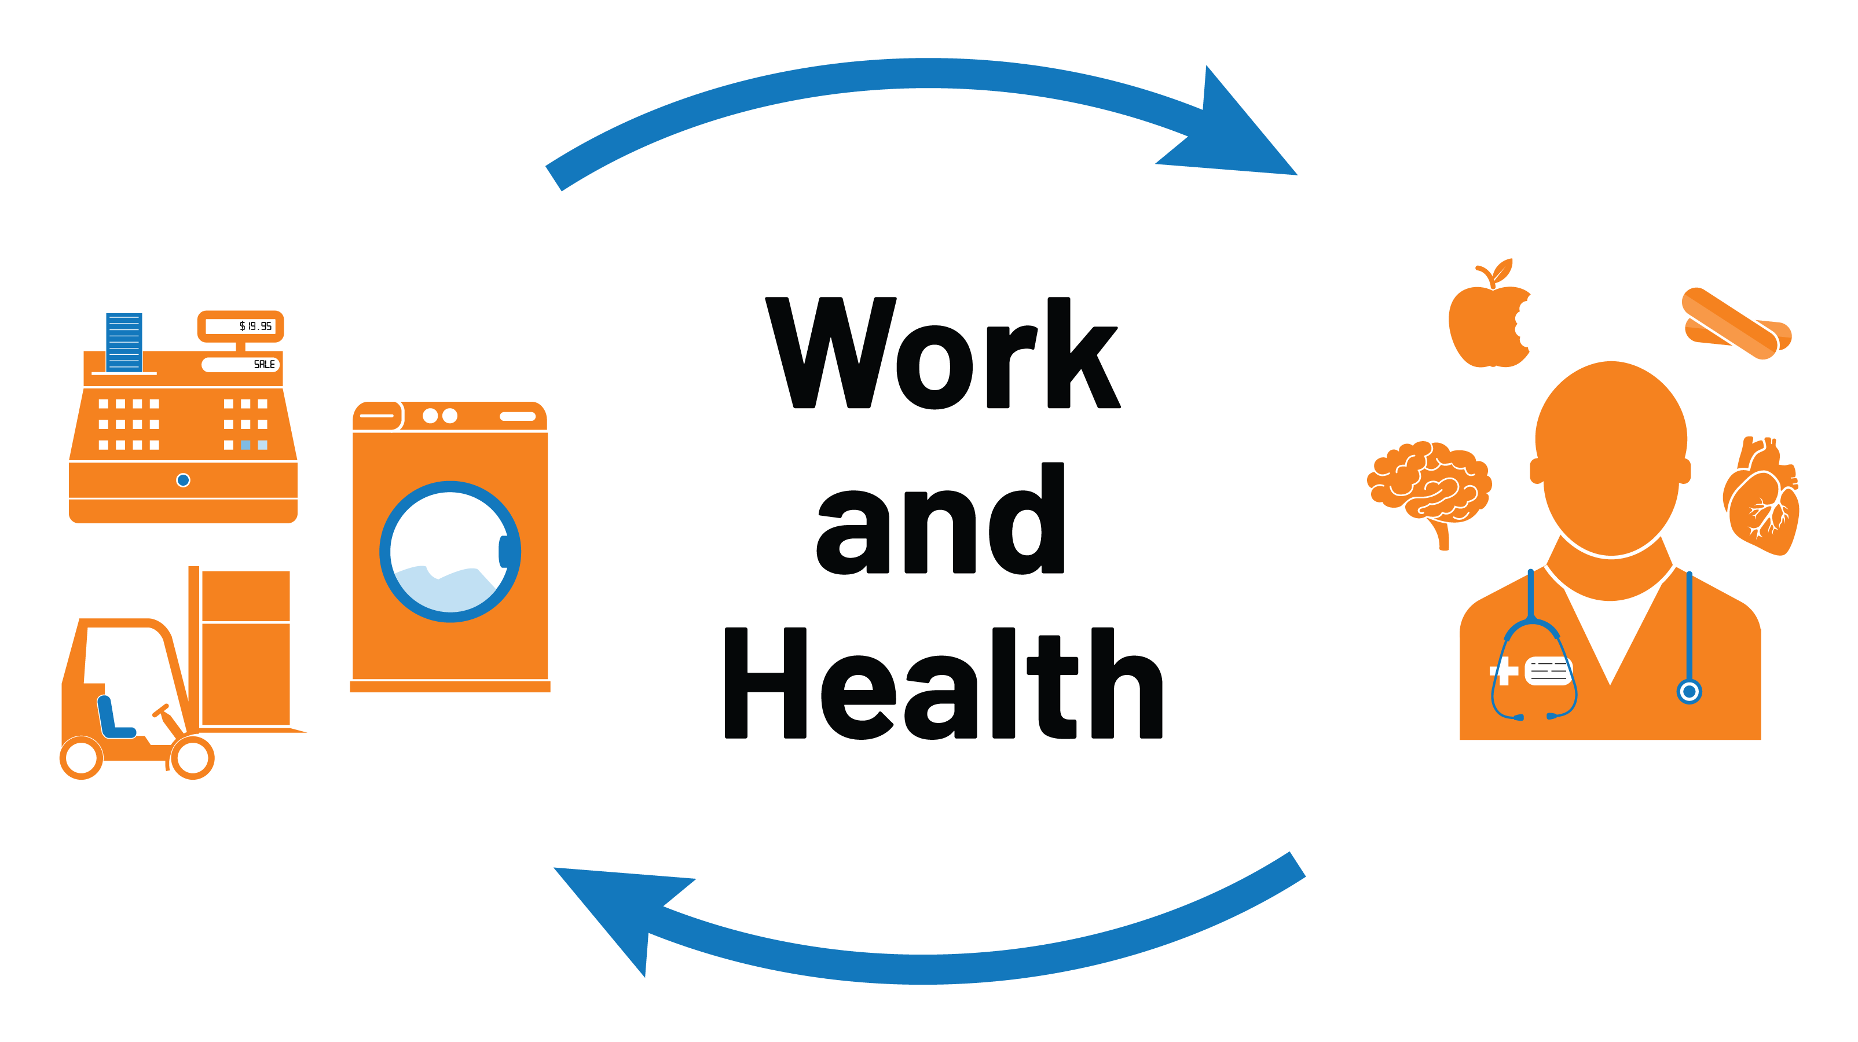
WHAT is Occupational Health?

Slide 5
Universal Access
World Health Organisation (WHO) and International Labour Organisation (ILO) 1994
WHO Global Strategy and World Health Assembly 1994
“Fundamental right of each worker to the highest attainable standard of health”.
“Access to occupational health services should be ensured for all workers of the world irrespective of age, sex, nationality, occupation, type of employment or size or location of the workplace”

Slide 6
WHAT impact?
Health on Safety
Work on health
Chronic conditions – epilepsy/ diabetes/ cardiac
Mental health/alcohol
Neurodiversity
Long covid - fatigue/SOB/performance/ cognition
Workplace injury/accidents
41,000 annually in Scotland and 17 deaths in 20/21 _{(HSE)}
Covid infection from workplace exposure
Covid-risk: Covid-age

Slide 7
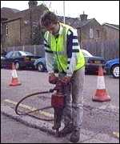
Case Study
Jimmy 45y Wife & 2 kids
Contractor
Minimal Health and Safety training
Minimal access to OH &S advice via employer
No safe systems of work

Slide 8
Case Study Jimmy 45y
Health issues
Early noise-induced hearing loss
Early vibration white finger
Several eye injuries in the past
Irritant dermatitis from exposure to cement and friction
Osteoarthritis of spine, shoulders, elbows and knees
Past back injury
A broken bone in hand
Getting “a bit past it”

Slide 9
He has an accident at work – pipe
Factures of right tibia and fibula
Taken to hospital – great treatment
but
No record of job in the hospital notes
No physiotherapy
Gets sickness certificate
No guidance about rehabilitation

Slide 10
Rests at home, watches TV (gets depressed)
Wasting of quadriceps (50%) and reduction in power both legs, pain at fracture site
At six weeks starts physiotherapy
Pain and weakness still a problem
GP advises job will be too much for him
Follow up hospital appointment – no discussion about work
Sacked - on Benefits

Slide 11
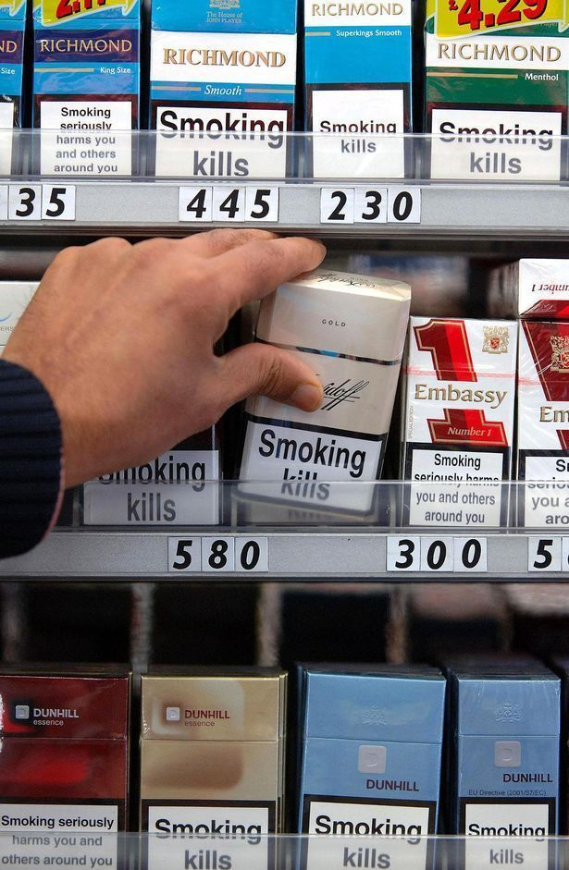
Worklessness – WHY important to avoid at all costs?

Slide 12
Unemployment is bad for you:
-Loss of Income¹
-Destructive on self-respect¹
-Risks of ill-health²
-The “psychosocial scar” persists³
-Trans-generational effects
Winkelmann and Winkelmann 1996
Clark, Georgellis, Samfey 2001
Clark and Oswald 1996
Aylward 2006

Slide 13

Healthy Working Lives
A One Stop Shop for all OH & Safety Advice, free at the point of delivery
Single advice-line
Workplace visits
Access by SMEs
Training
National projects
Universal Access

Slide 14
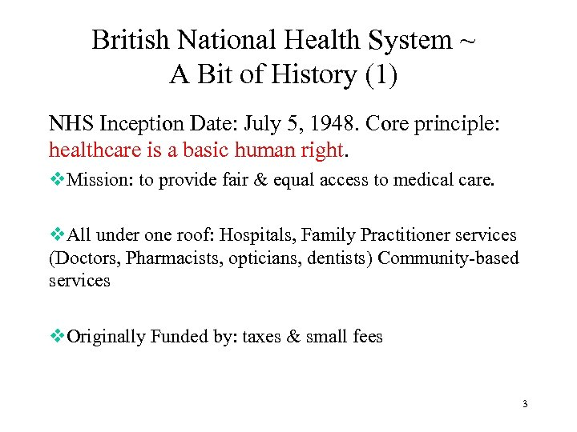
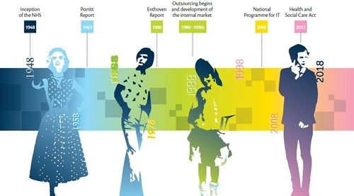
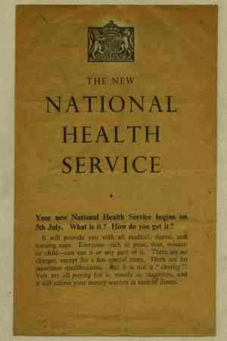
WHY is OH not part of the NHS?

Slide 15
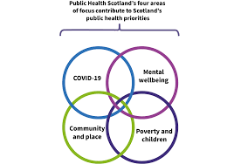
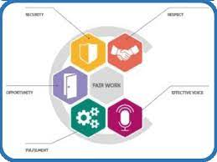
Where does OH sit strategically?
Public Health Scotland? - NO
Fair Work Nation? - NO

Slide 16
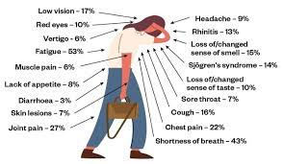
What health challenges for Scotland’s workforce in future?
Long covid – affecting 130,000 working age people, inadequate NHS services in Scotland and need for OH advice

Slide 17

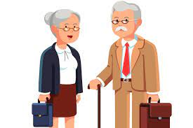
Home working without support
Aging population

Slide 18

WHAT are the challenges for OH?

Slide 19

What do we need?
A strategic home
With a view to:
Universal Access
Via an Occupational Health Service for Scotland based on HWL model
Provide a centre for health and work with OH academia and benchmarking OHS
Attract OH people and fund OH training for the future of Scotland’s workforce

Slide 20
Thank you
Dr Sue Blair MBChB, FFOM
sue.blair@nhs.scot
On behalf of SOHAG

