Slide 1
Safety in mind
Katrina Phillips, Chief Executive
Child Accident Prevention Trust

Slide 2
Why Child Safety Week?
Statistics are people with the tears wiped away
17
1 in 13
6,115
1 in 7

Slide 3
Our vision
All children lead active, healthy lives,
safe from the disabling effects
of serious accidental injury

Slide 4

Child Safety Week 6-12 June
Free resources to use and share
Parents pack
Fact sheets x 8
Translations x 5 languages
Session plans x 8
Poster
Logo

Slide 5
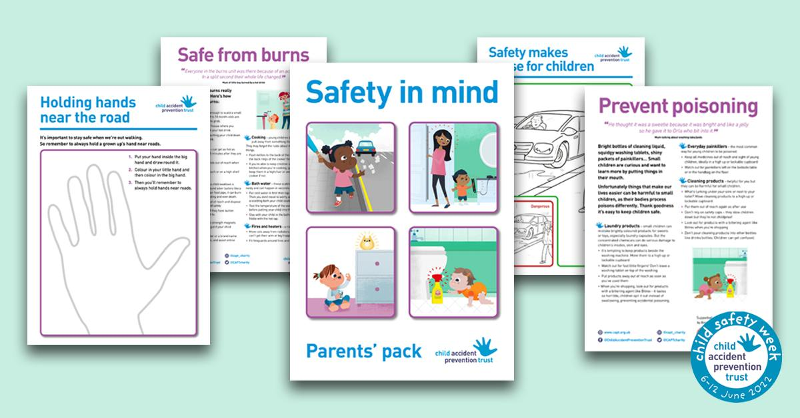
Parents pack

Slide 6
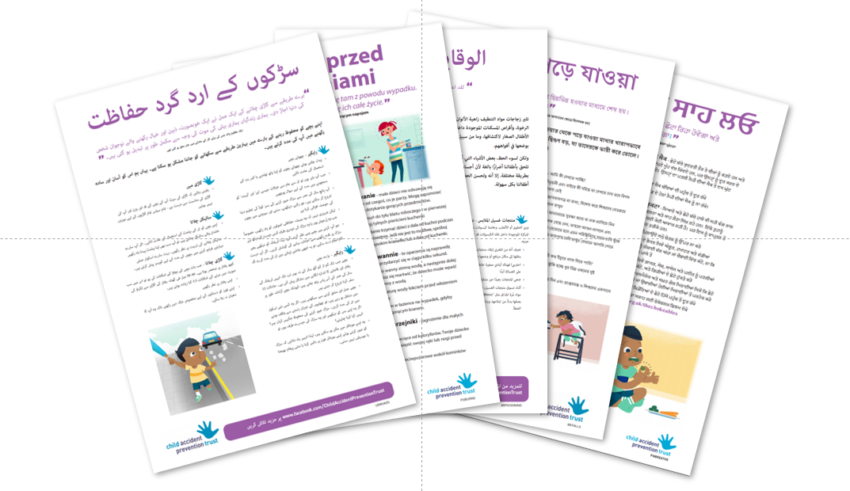
Advice in translation

Slide 7
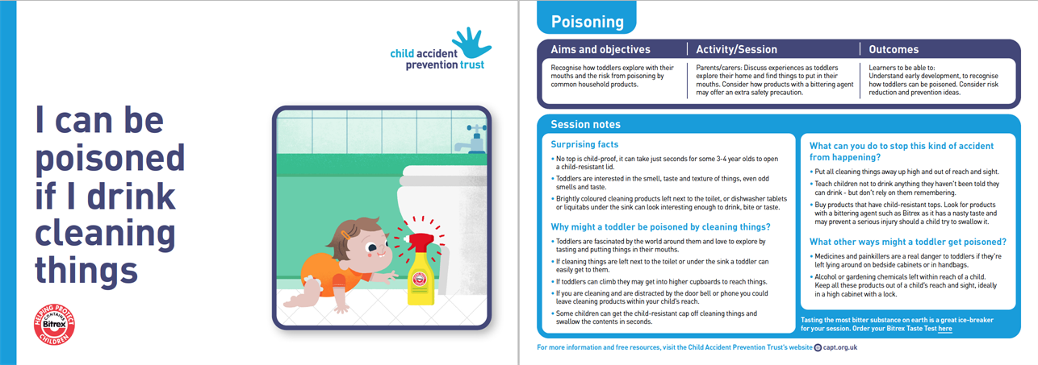
Session plans

Slide 8

Social media

Slide 9
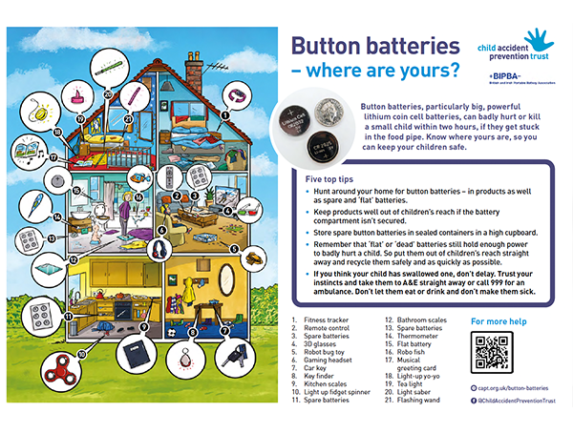
Button batteries

Slide 10

Online marketplaces

Slide 11
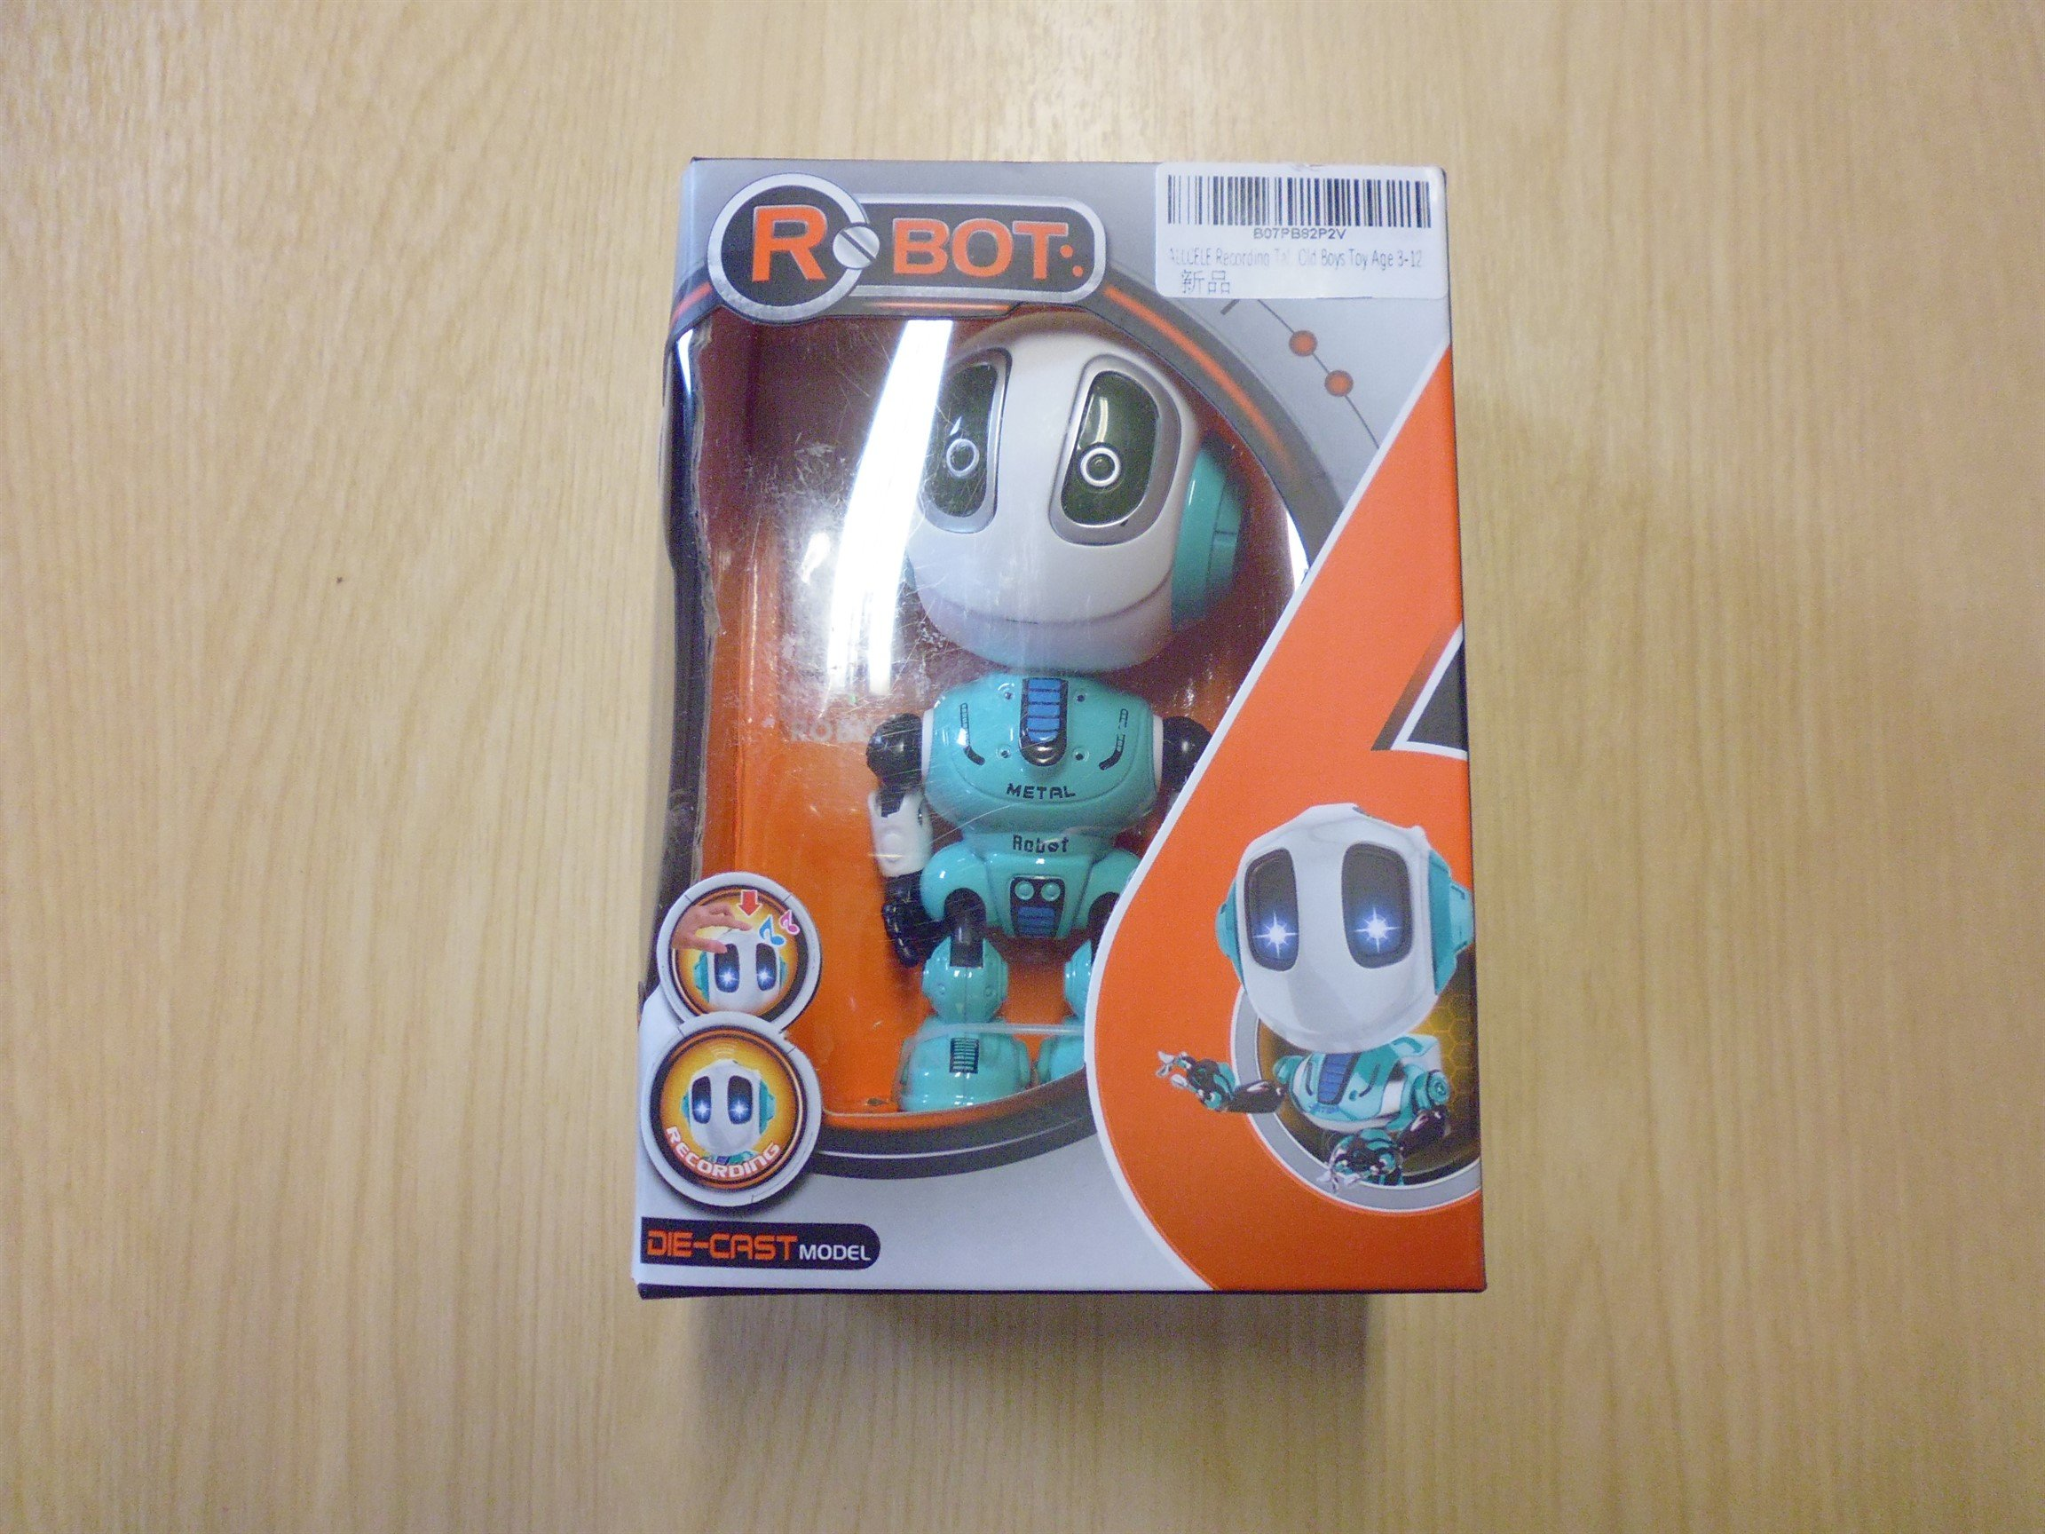
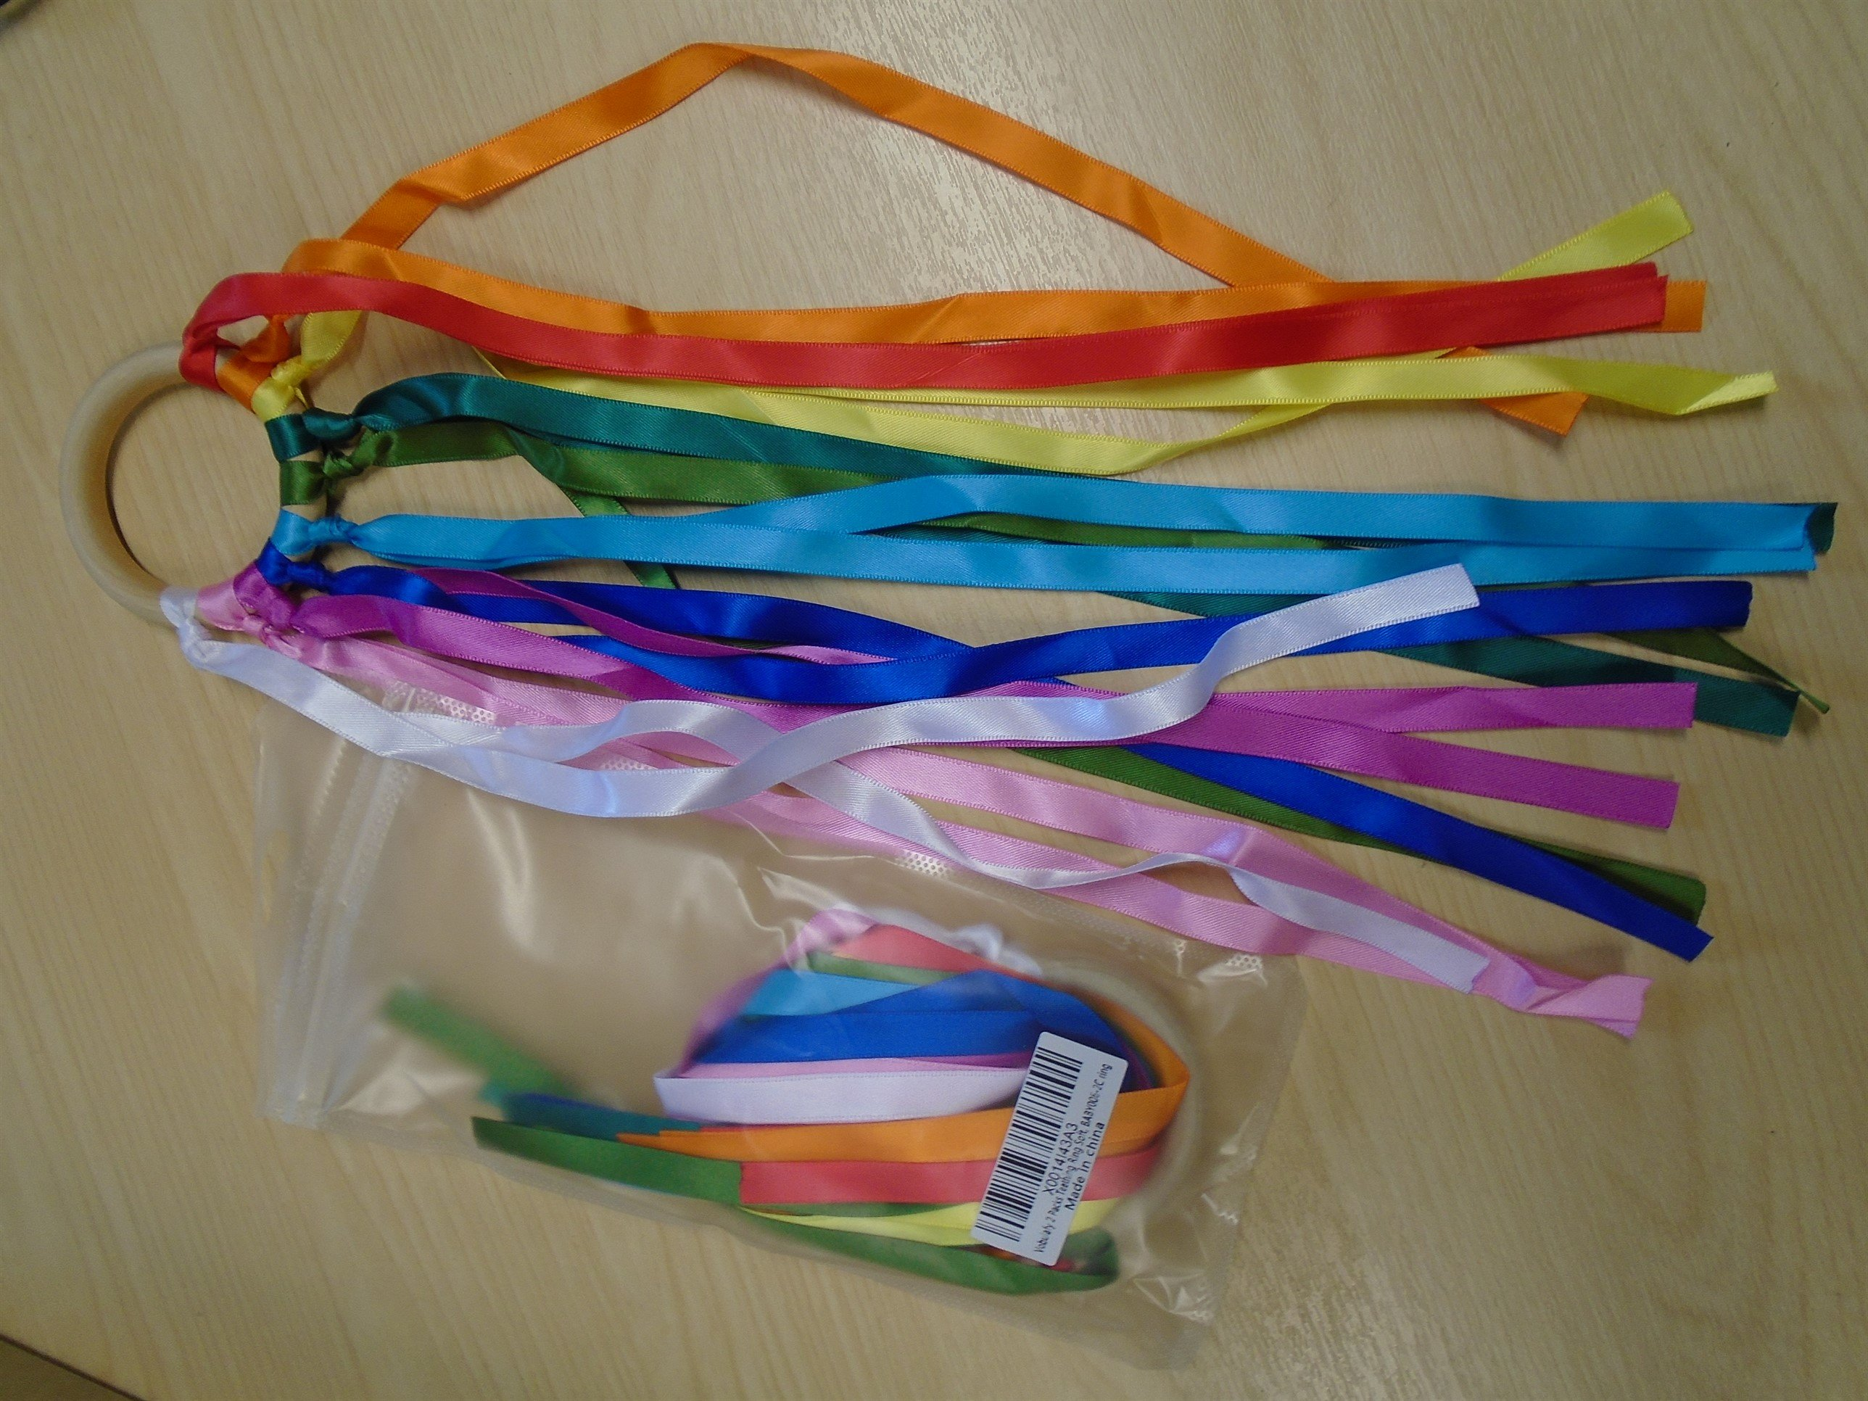
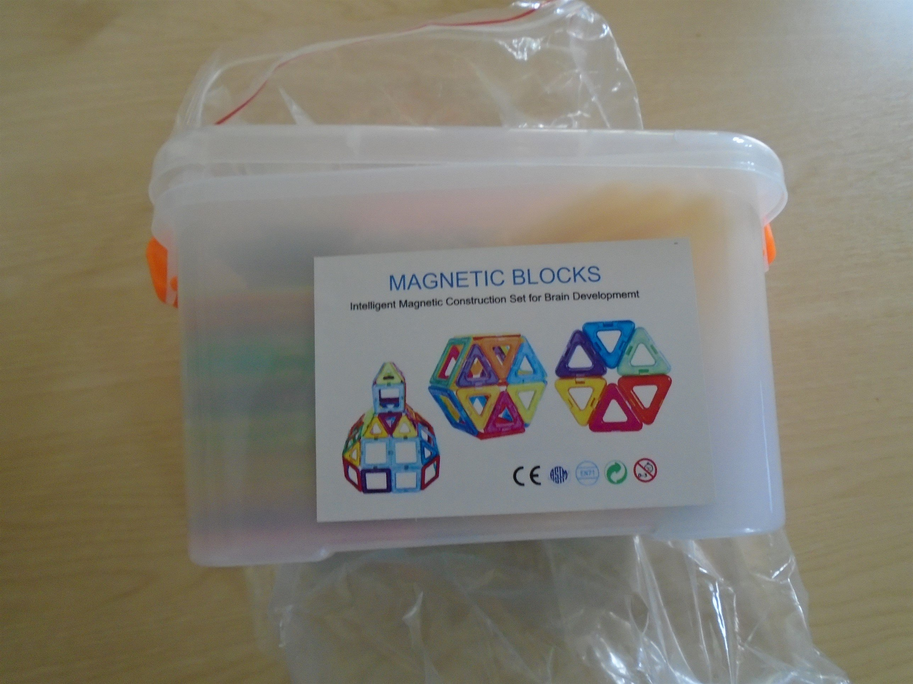
Serious safety failings

Slide 12
Cost of living crisis
“Children under five living in disadvantaged households in Scotland are more likely to suffer severe and multiple injuries in their homes than children from better-off families”
Glasgow University

Slide 13
Stay in touch
Join our subscribers across Scotland https://www.capt.org.uk/sign-up
Facebook https://www.facebook.com/ChildAccidentPreventionTrust/
Instagram https://www.instagram.com/capt_charity/
Twitter https://twitter.com/captcharity
Website: www.capt.org.uk

