Slide 1
Public Rescue Equipment & what works
Isolation fencing
Highest confidence in evidence base/repeat/transfer
Survival technique for cold waters <15c
i.e. Float to live
Lifejackets
and PPE
Soft pool/pond covers
Basic swim and w/s ability:
6-11yo
Supervision:
Close- Constant-Competent
‘Old style’
Baby bath seats
Rescue Equip & Signs
High quality CPR/EAV & Early hospitalisation
Hands
only CPR
Lifeguards: Adequately trained, equipped ect
‘Self-rescue’
Among u-5yo
It Works …Might …Doesn’t Might be harmful
Selected global strategies to reduce or prevent harm
(Various)

Slide 2
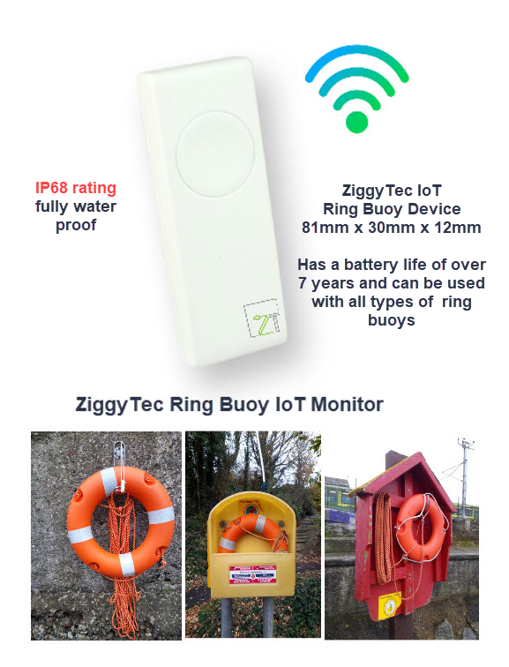
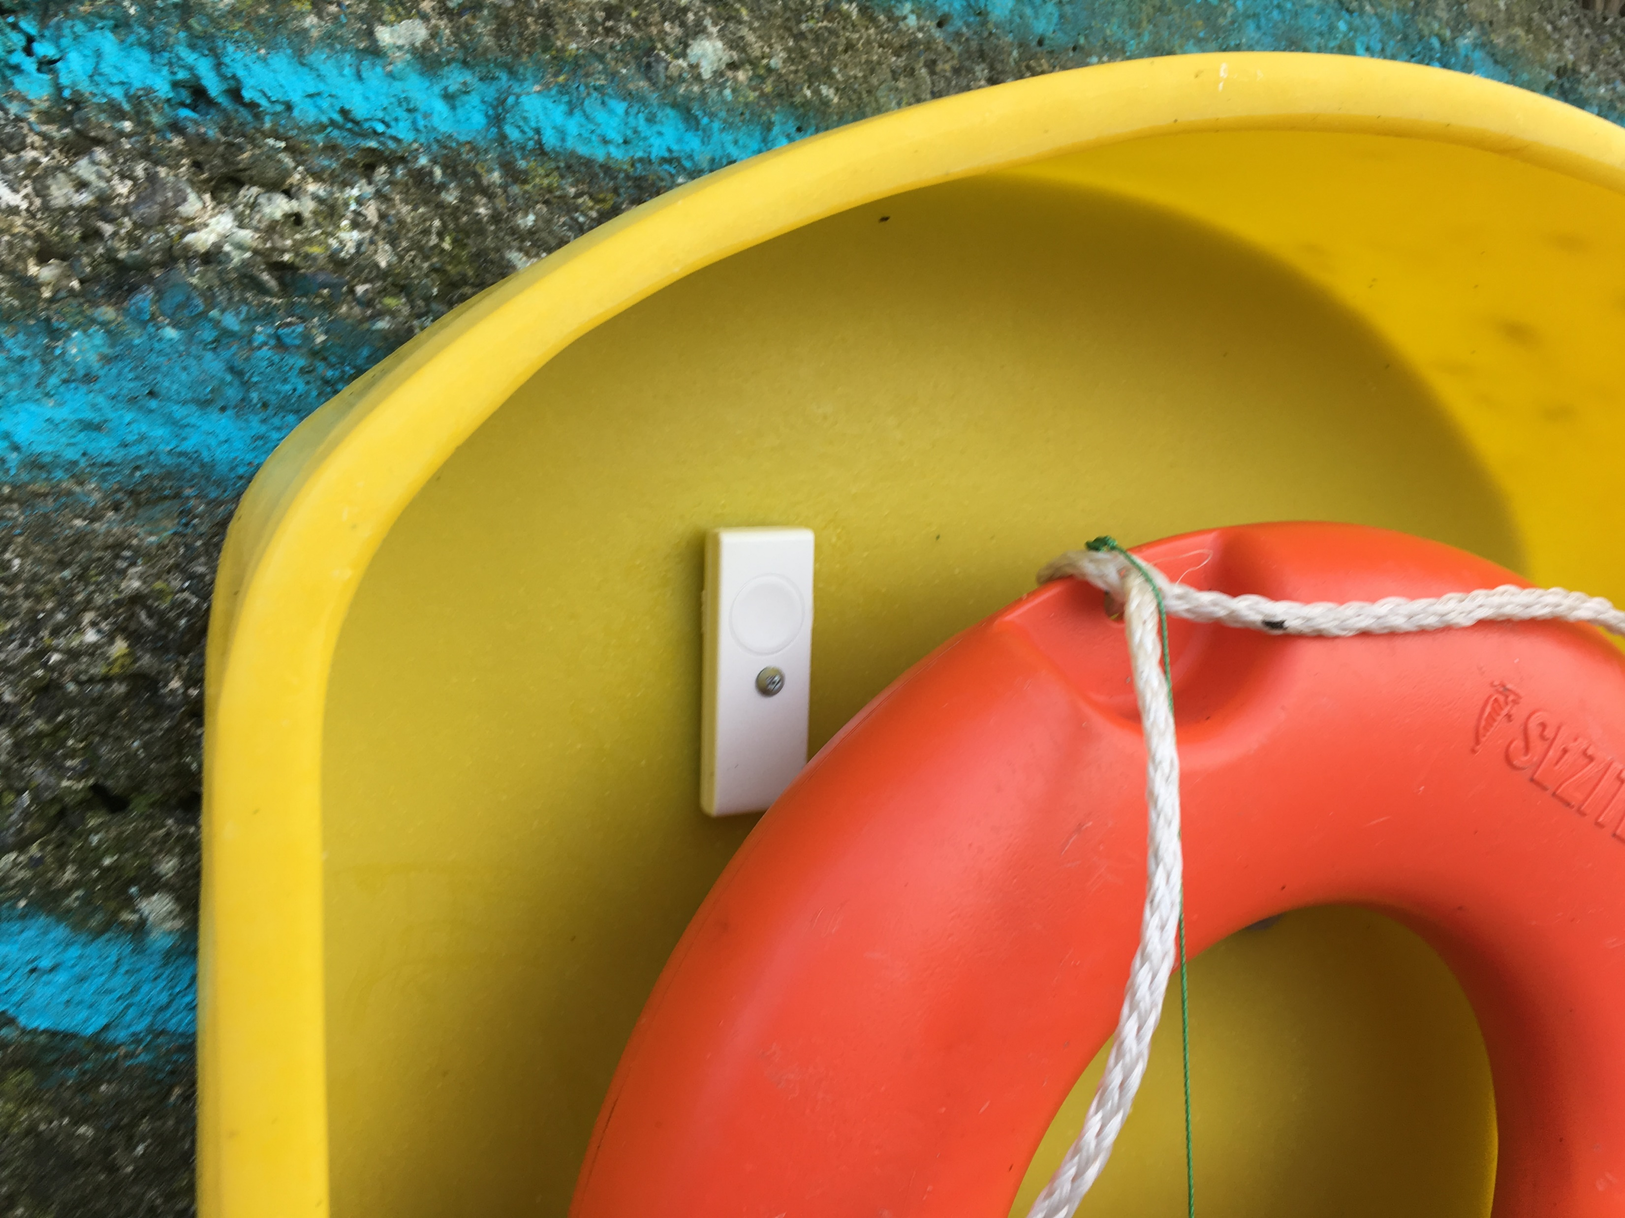
Smart Buoy – RoSPA Project
Retrofit to ANY existing Unit

