Slide 1
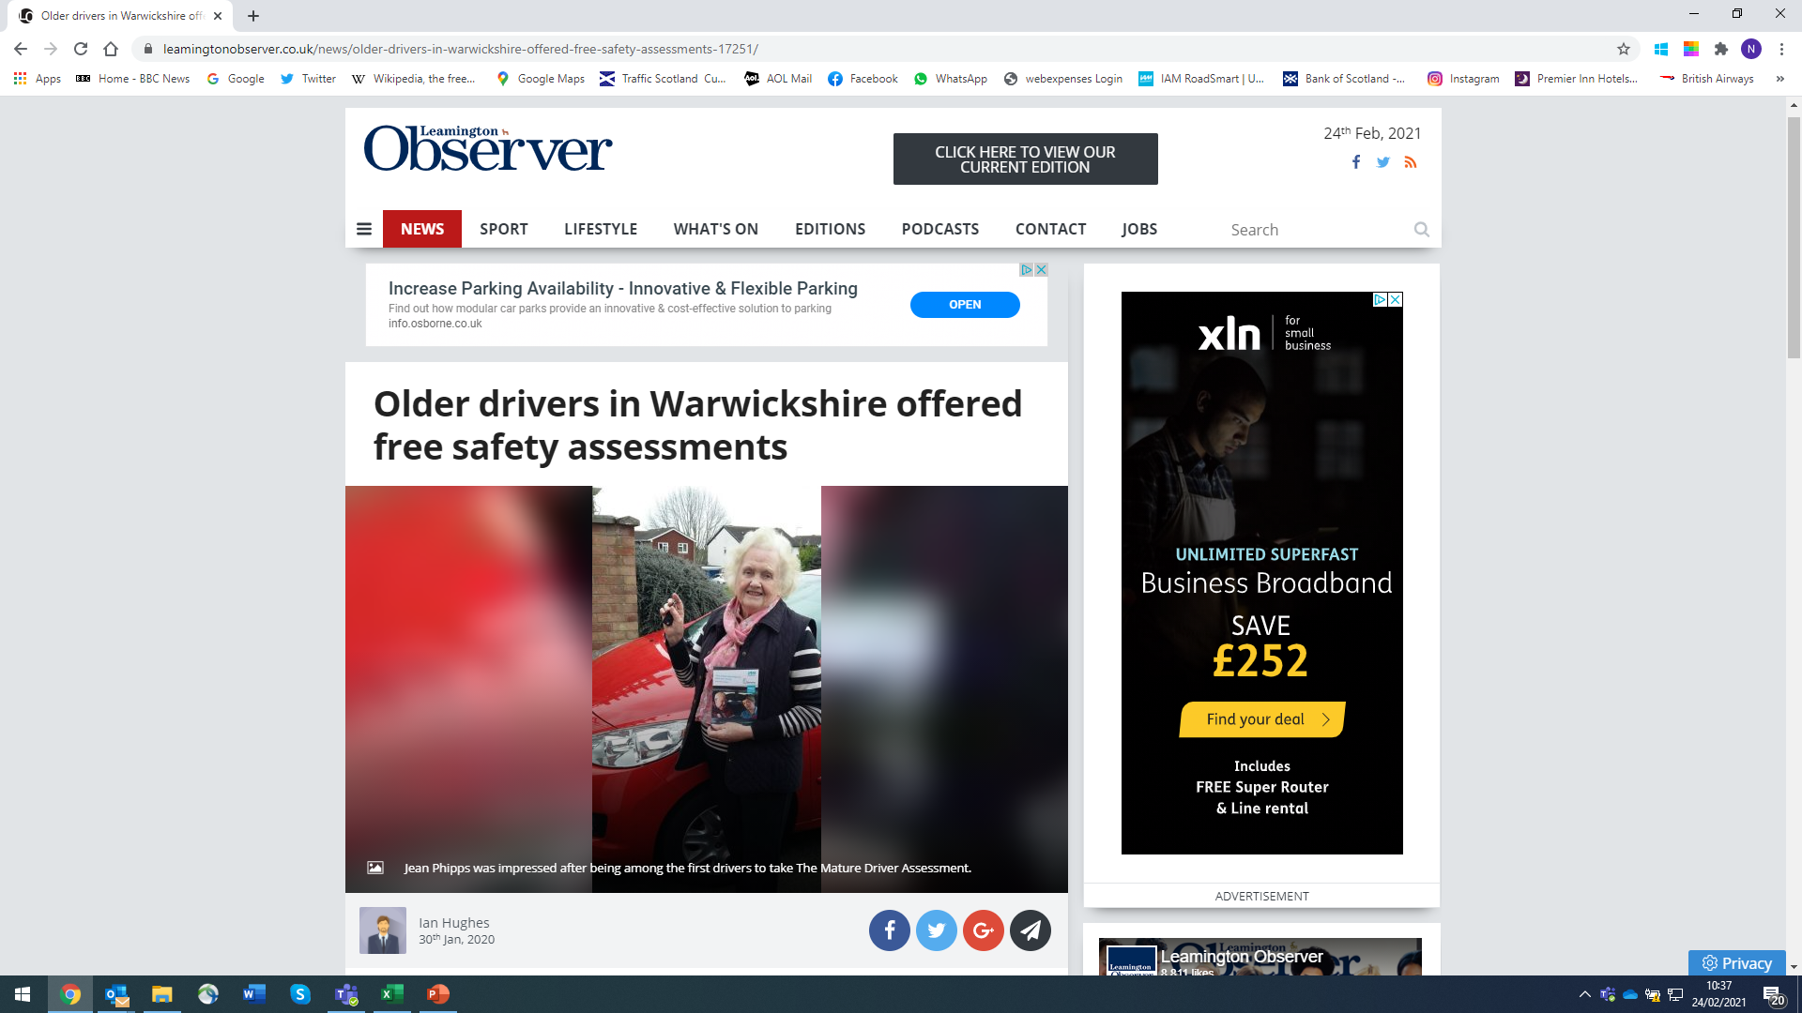
Mature Driver assessments
A partnership approach?

Slide 2
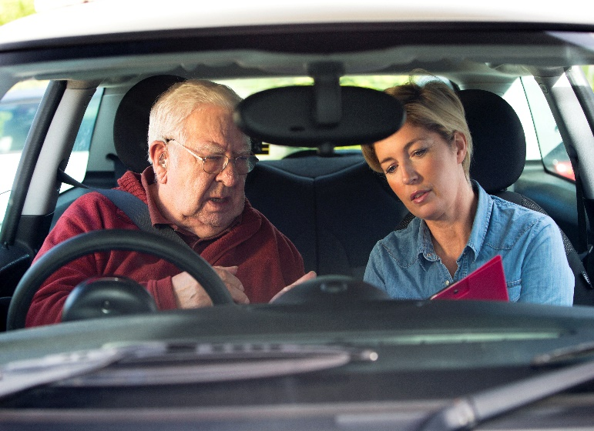
IAM RoadSmart’s solution
Mature Driver Assessment (MDA)
60 minute drive which costs £49
IAM qualified examiner or ADI
Own car/convenient time
Rated – Competent, Excellent, Needs Development or Safety Concern
Written report
Assess general driving/bad habits

Slide 3
IAM and Warwickshire CC
Warwickshire County Council has teamed up with IAM RoadSmart and Specsavers, to provide and promote, free driving assessments for eligible mature drivers.
109 drivers took part at the last analysis – Covid 19 has delayed things!!
58 male/51 female with an average age of 80.
Oldest – 94
Youngest - 69

Slide 4
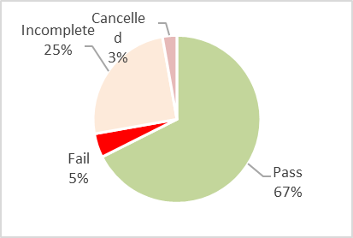
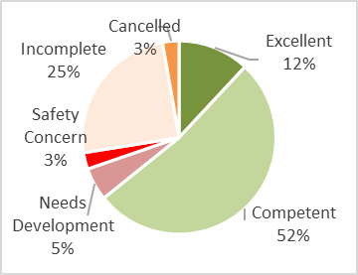
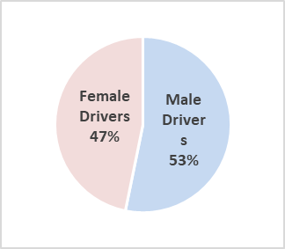
IAM RoadSmart/Warwickshire Council

Slide 5
IAM MDA Summary
We are working with local councils, road safety partnerships and the police in areas such as Dorset, Warwickshire and the Highlands.
IAM RoadSmart can develop a tailor-made package for your local area
Partnership working on public relations and marketing
Get in touch with us and see what we can deliver together for safe mobility for mature drivers in your area
  Councillor Les Caborn (Warwickshire) said: “We’re delighted to be working with IAM Roadsmart and Specsavers to provide and promote these free driving assessments for eligible mature drivers.
  “If you, or a friend or relative living in Warwickshire feel you may benefit from this valuable opportunity then please get in touch. We want all our older drivers to drive safely and with confidence.

Slide 6
Thank you for listening
Questions?
Neil.Greig@iam.org.uk
Notes:
Caroline to thank Neil and welcome any questions for Sarah and Neil.

