Slide 1





Dr Martin McKechnie
National Clinical Lead
Scottish Trauma Network
NHS National Services Scotland
Consultant in Emergency Medicine
NHS Lothian
@ScotTraumaNwk
nss.scottrauma@nhs.scot
0131 314 1586

Slide 2
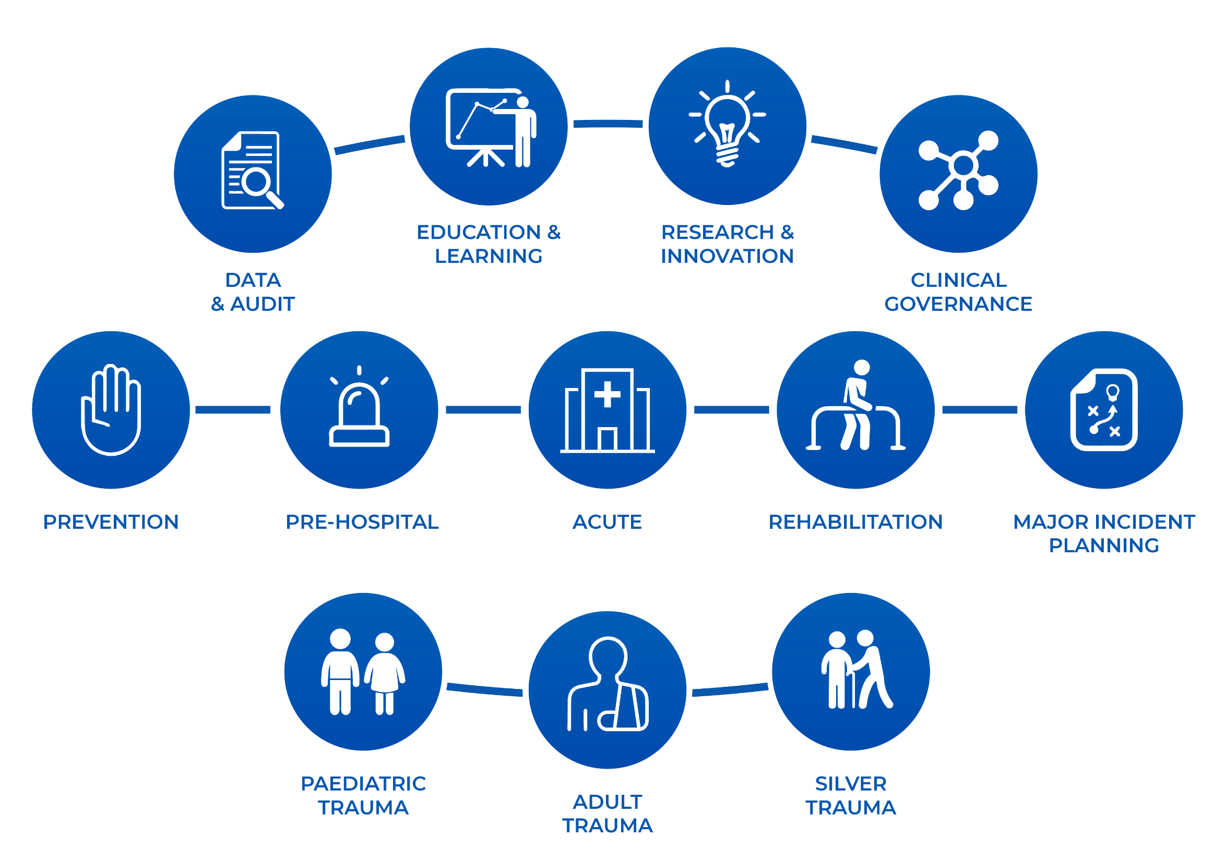


Slide 3



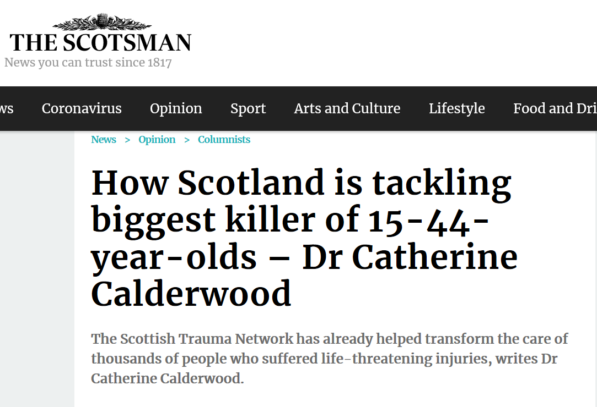



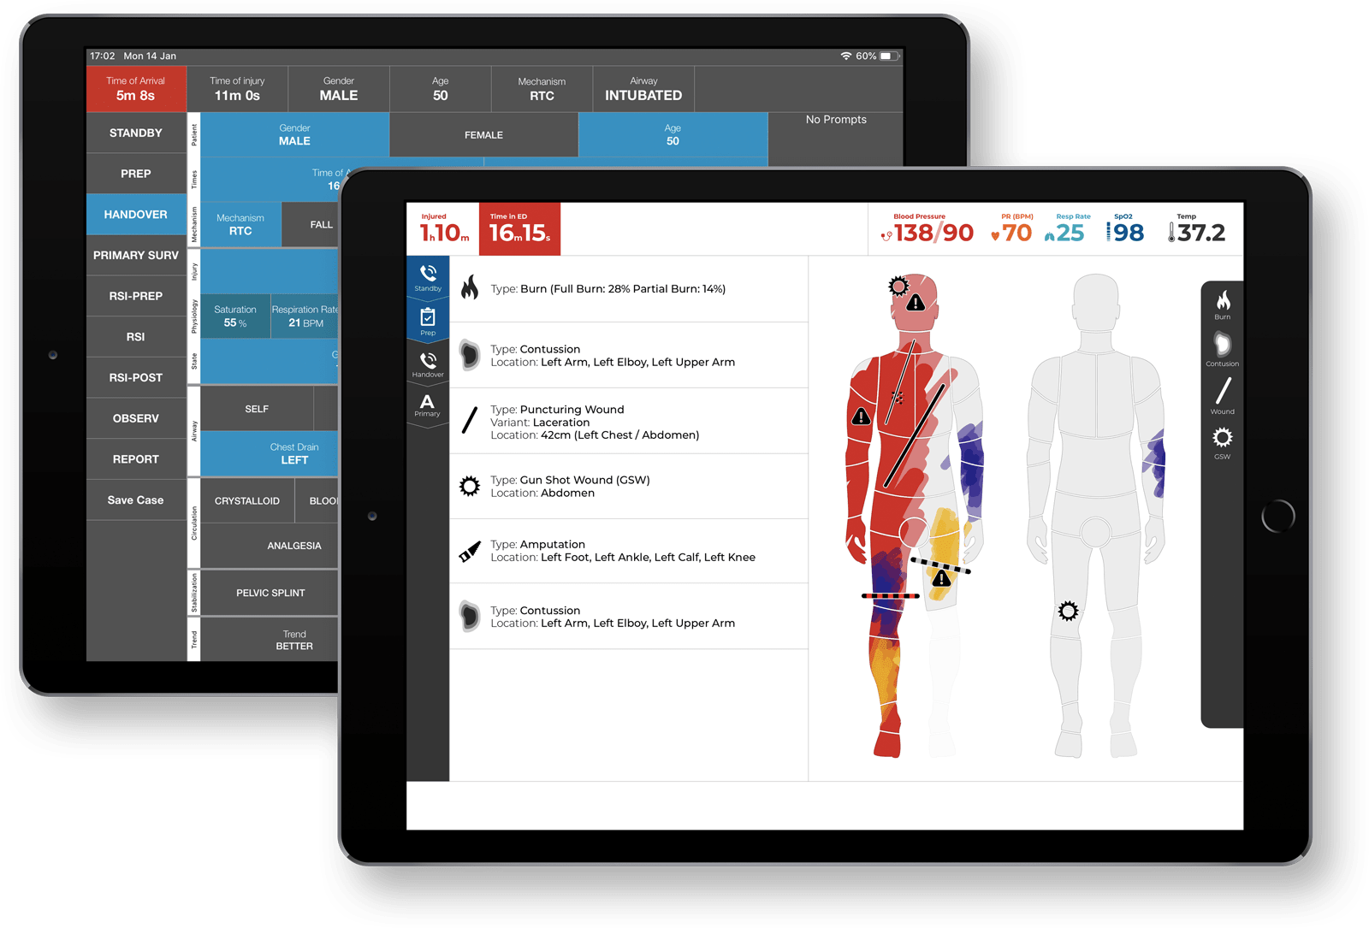


Telling the Story – Scottish Trauma Network

