Slide 1


Reshaping of Care for Older People
PHYSICAL ACTIVITY THEME
Melanie Menzies
Health & Well Being Manager
North Lanarkshire Leisure Ltd
Melanie.menzies@nlleisure.com
01236 341709
www.nlleisure.com

Slide 2


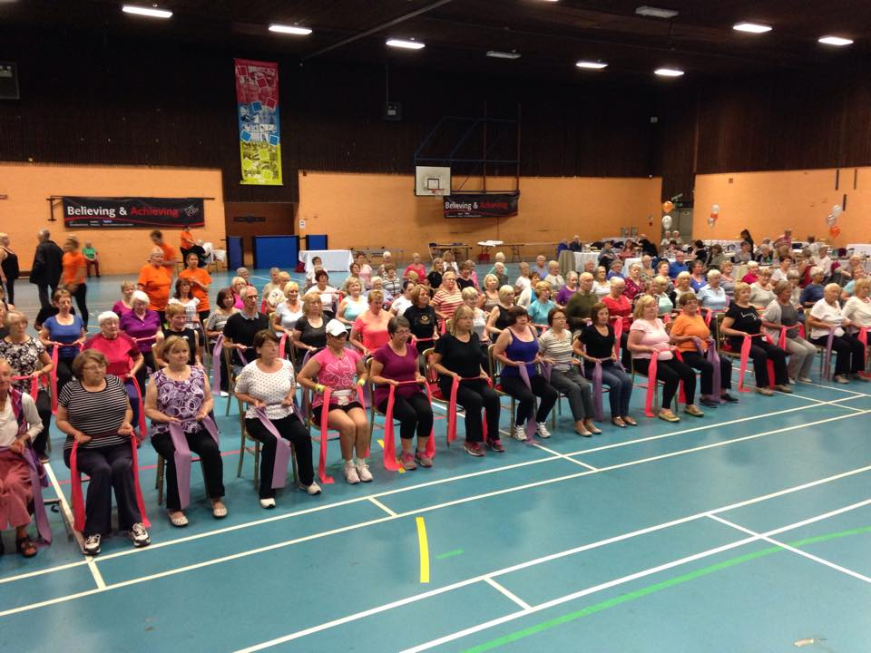
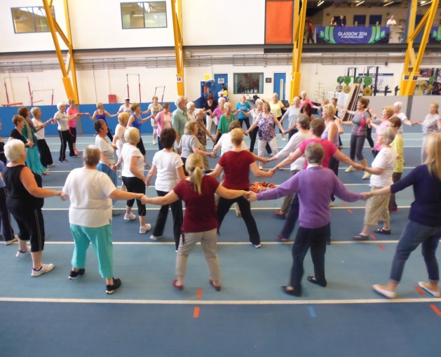
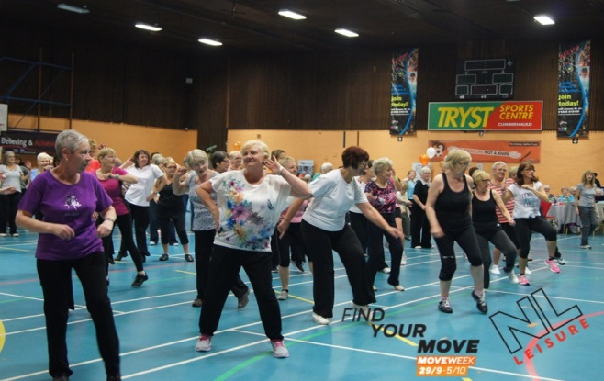
Reshaping of Care for Older People
PHYSICAL ACTIVITY THEME
Key Aims
To develop a co-ordinated approach to the provision of physical activity across NL
To maximise use of existing services
Strengthen existing referral pathways for older adults to PA
To link community based activity as a cross cutting theme
To deliver a training programme for PSI Instructors

Slide 3
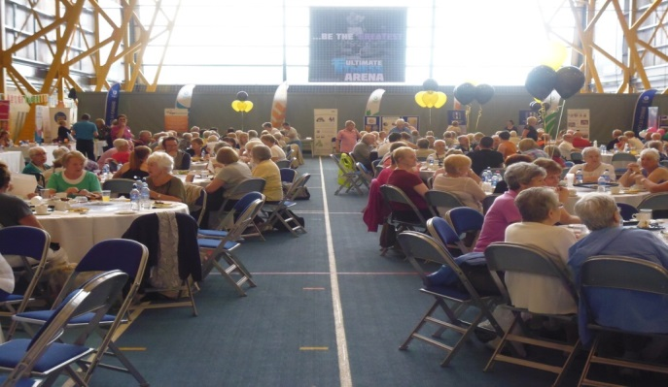
Reshaping of Care for Older People
PHYSICAL ACTIVITY THEME
The Programme
Mapping Exercise
PSI Training - 2 completed 2013/2014
Peer Mentoring – 3 sessions – 76 Participants
S Housing /C Homes/Com Groups - 48 weekly sessions
Commonwealth Celebration of Older Adults/ Move Week 2014 – 578 participants
New centre based referral classes – 10 weekly sessions
Spreading the word!!! Get our older adults moving!!

Slide 4
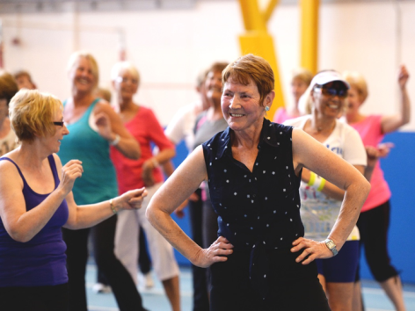
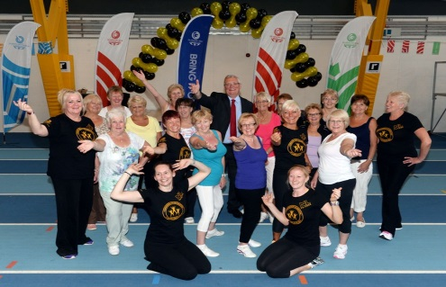
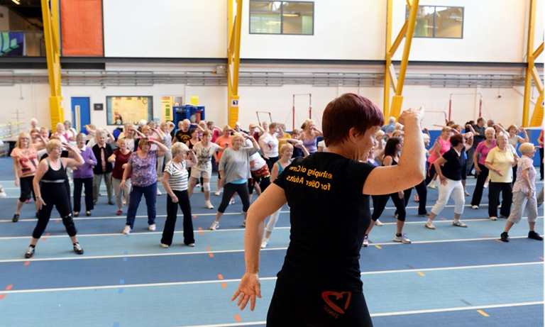
Reshaping of Care for Older People
PHYSICAL ACTIVITY THEME
Final Phase to March 2015
DVD Home Exercise sessions
Peer Mentoring x 2 sessions
Home Exercise Booklets and Bands
Newsletter
Evaluation

