Slide 1
Graham Thomson
The Road Safety Framework: Working in Partnership

Slide 2


Slide 3
Vision
“A steady reduction in the numbers of those killed and those seriously injured, with the ultimate vision of a future where no-one is killed on Scotland Roads and the injury rate is much reduced”

Slide 4
Framework Targets
Target | 2004 – 2008 average | 2015 milestone % reduction | 2020 target % reduction
People killed | 292 | 30 (204) | 40 (175)
People seriously injured | 2605 | 43 (1484) | 55 (1172)
Children (aged < 16) killed | 15 | 35 (10) | 50 (8)
Children (aged < 16) seriously injured | 325 | 50 (163) | 65 (114)

Slide 5
People killed
Numbers killed
Baseline – 2004-08 avg.
300
Milestone:
-30%
by 2015
Target:
-40% by 2020
250
200
150
2004
2006
2008
2010
2012
2014
2016
2018
2020

Slide 6
People seriously injured
Numbers seriously injured
2800
Baseline – 2004-08 avg.
2200
Milestone:
-43%
by 2015
Target:
-55% by 2020
1600
1000
2004
2006
2008
2010
2012
2014
2016
2018
2020

Slide 7
Children killed
Children killed
30
20
Baseline – 2004-08 avg.
Milestone:
-35%
by 2015
Target:
-50% by 2020
10
3-year moving average
0
2004
2006
2008
2010
2014
2016
2020
2012
2018

Slide 8
Children seriously injured
Children seriously injured
400
Baseline – 2004-08 avg.
300
Milestone:
-50%
by 2015
Target:
-65% by 2020
200
100
2004
2006
2008
2010
2012
2014
2016
2018
2020

Slide 9
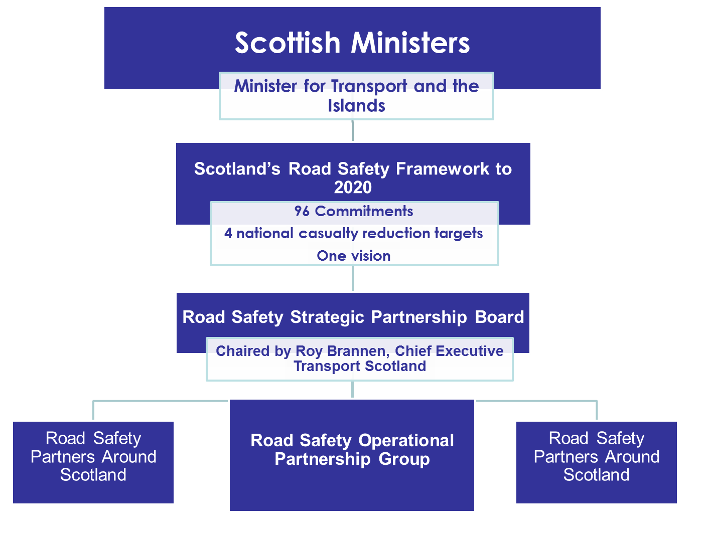

Slide 10
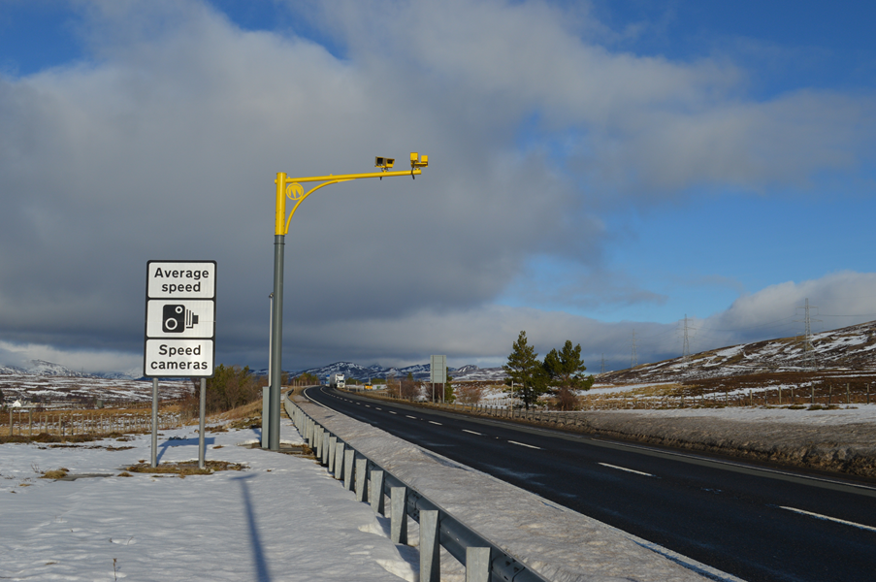

Slide 11
















A9 Safety Group

Slide 12
Mid-term checkpoint
The SPB undertaking a review of the progress being made towards delivering the Road Safety Framework to 2020
Evidence-based & focussed on three priority areas
Will re-double focus and momentum towards casualty reduction targets

Slide 13
Framework Priorities
Leadership Sharing intelligence and good practice Children Drivers aged 17 - 25 | Rural Roads Drink Drive Seatbelts Speed

Slide 14
Review Focus
3 review groups for 3 Priority areas:
Speed & Motorcyclists
Pre- Younger- & Older-drivers
Cyclists and Pedestrians

Slide 15
Review Approach
Participatory and ground-up
Sense-check progress on commitments
Identify and prioritise any new work
Identify outcomes and indicators
Identify strategic linkages
Agree monitoring and reporting

Slide 16
Where are we and next steps
Part way through individual review groups
Report on interim progress at SPB in December
Report to SPB in Spring 2016
Intention is to publish delivery plan before May 2016

Slide 17
Review Output
Overall high-level delivery plan to 2020
SPB will monitor underlying impact which is supporting Framework targets
Will identify where greatest impact and changes are being delivered
Will support continued partnership working in achieving targets to 2020

Slide 18
Graham Thomson
Transport Scotland

