Slide 1
Falls Prevention and Management in Scotland
A National Perspective
CPG on Accident Prevention and Safety Awareness
Tuesday 20th December
Ann Murray
National Falls Programme Manager ann.murray3@nhs.net

Slide 2

Why falls matter
For an older person a fall can be…
trivial, profound or fatal,
the first sign of a new or worsening health problem,
a marker for the onset of frailty,
a ‘tipping point’ leading to loss of confidence and independence, and increased dependence on family, and health and social services.
A fall is a symptom, not a diagnosis.
“I was never the same after the fall”
“I suddenly became an old person”
“I don’t really feel the same person”
“I was thoroughly demoralised”
NHS QIS Focus Groups, October 2008

Slide 3
Why falls matter
Scale and cost
In people 65 years and over:
Largest single presentation to the Scottish Ambulance Service (over 35,000 attendances).
One of the leading causes of Emergency Department attendance.
Responsible for over 390,000 emergency bed days.
Implicated in up to 40% care home admissions.
Highest reported incident in hospital settings.
Costs to health and social care services in Scotland estimated to exceed
£471m each year (est. rising to £666m by 2020):
  45% long term care
  40% NHS
  15% care at home
( £39,500 per hip fracture) (Craig 2012)
Notes:
Why falls?

Slide 4
Falls are not an inevitable part of getting older
Recognising and modifying risk
Fall
ENVIRONMENT
Uneven floor or ground surface
Inadequate lighting
Low temperature
Clutter
Pets
PERSON
Reduced muscle strength, balance, mobility
Impaired vision
Blood pressure drop
Cognition & behaviour
Some medication / Alcohol
Feet, footwear, clothing
TASK or ACTIVITY
Notes:
A complex interaction of risk factors
Recognising and modifying risk factors is crucial in preventing falls and injuries from falls.

Slide 5
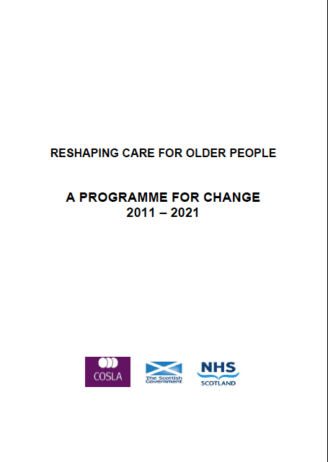
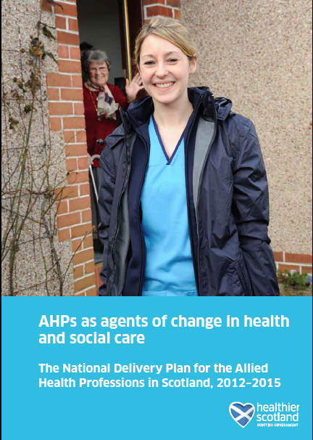
Falls Prevention and Management in Scotland
Policy context: creating the conditions
2007
A Delivery Framework for Adult Rehabilitation in Scotland
Older people one of three priorities.
2007
Health Department Letter
Actions
Falls Leads.
Combined Falls & Bone Health Strategy.
Integrated pathway.
Community of Practice.
2010
Reshaping Care for Older People.
A Programme for Change 2011-21
Change Fund
£370million
2011-2015
2012
The National Delivery Plan for
Allied Health Professions in Scotland 2012-2015
Actions
Pathway development.
Implementation Plans.
Notes:
Creating the conditions

Slide 6
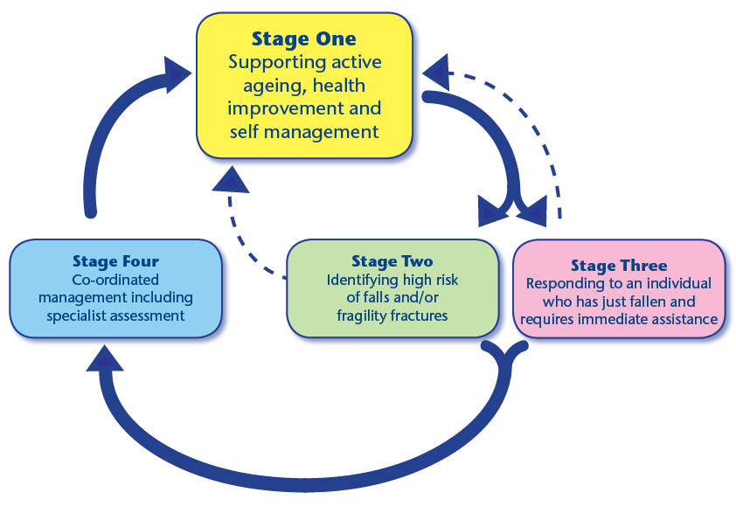
The National Falls Programme in Scotland (2010 – present)
What are we trying to accomplish?
To reduce the personal, system and societal costs associated with falls in Scotland.
For every health and social care partnership area in Scotland (32 partnerships) to have a local integrated falls prevention and management and fracture prevention pathway for older people in operation.
People have the opportunity to receive the right care and support, at the right time, in the right place to prevent harm from falls, every time.
The Up and About Pathway (2010)
http://www.knowledge.scot.nhs.uk/fallsandbonehealth/the-national-falls-programme.aspx
Notes:
Community, inclusive, spans…
Pre 2010 ad hoc

Slide 7
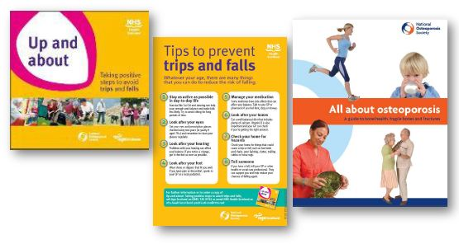



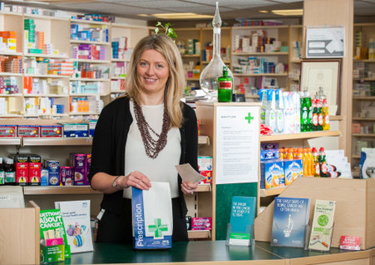
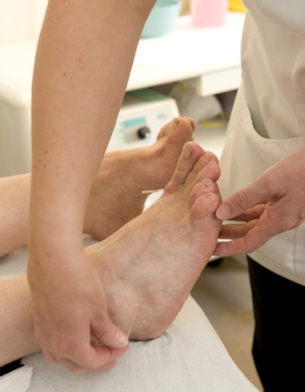
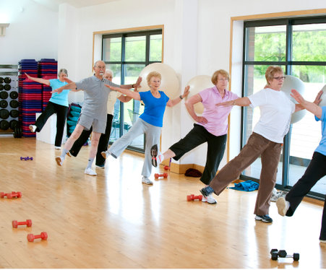

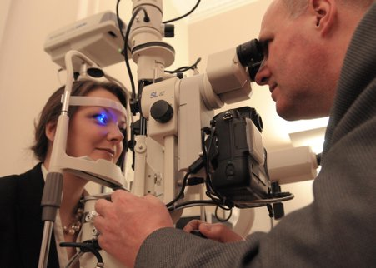

Stage One of the Pathway
Supporting active ageing, health improvement and self management
Safe home environment
Falls prevention and bone health information
Safer community
environment
Keeping well
Keeping physically active
Notes:
This includes information on how to access resources, equipment, local services and organisations, which aim to support:
keeping healthy and well
a safe home environment
a safer community environment

Slide 8
The National Falls Programme in Scotland
What are we doing?
The Falls Programme Manager in partnership with Falls Leads network and a range of stakeholders:
Co-create a shared vision.
Provide practical guidance.
Share good practice, learning and experience; provide peer support.
Identify & deliver national work streams.
  “Do once for Scotland”
Nationally and locally, make falls prevention and management part of the conversation, when it needs to be.
Monitor progress and provide accountability.
The Up and About Pathway (2010)
http://www.scotland.gov.uk/Resource/0045/00459959.pdf
Notes:
Community, inclusive, spans…
Pre 2010 ad hoc

Slide 9
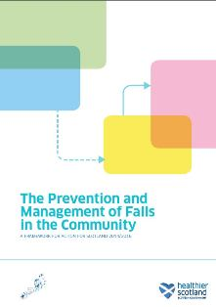
The National Falls Programme in Scotland
What are we doing?
The Falls Programme Manager in partnership with Falls Leads network and a range of stakeholders:
Co-create a shared vision.
Provide practical guidance.
Share good practice, learning and experience; provide peer support.
Identify & deliver national work streams.
  “Do once for Scotland”
Nationally and locally, make falls prevention and management part of the conversation, when it needs to be.
Monitor progress and provide accountability.
A Framework for Action for Scotland
2014/2016
http:// www.scotland.gov.uk/Publications/2014/10/9431

Slide 10
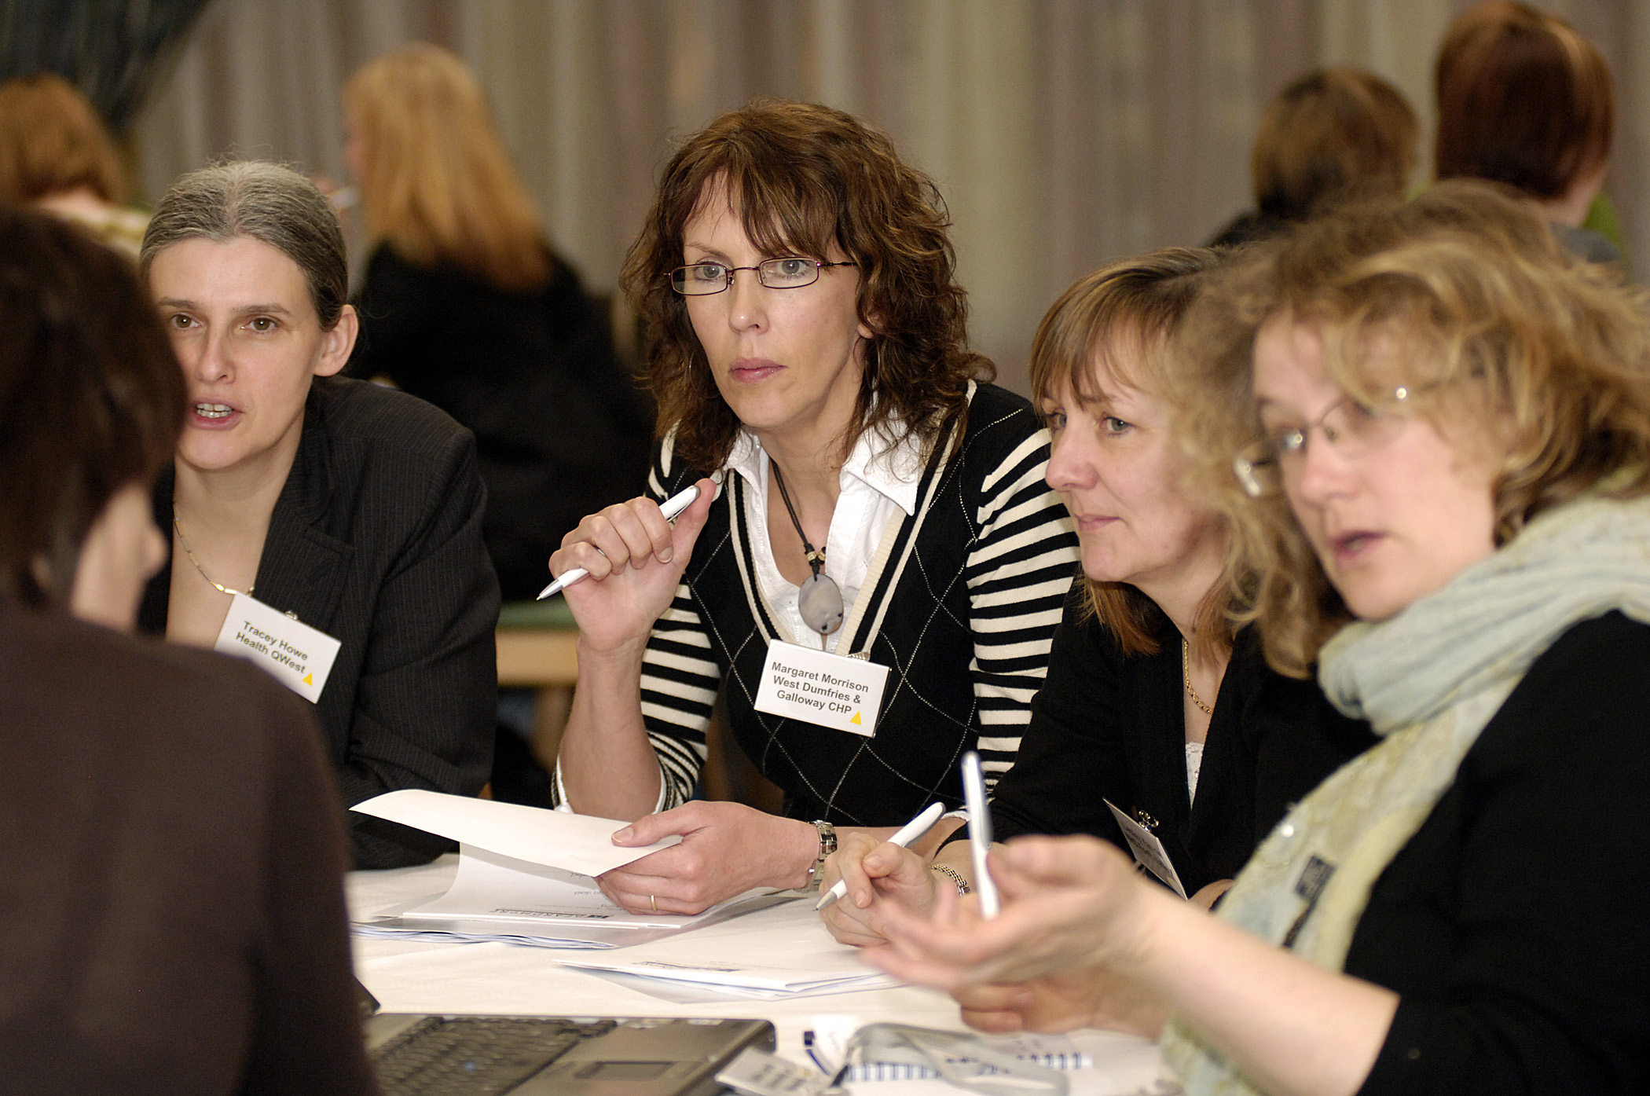
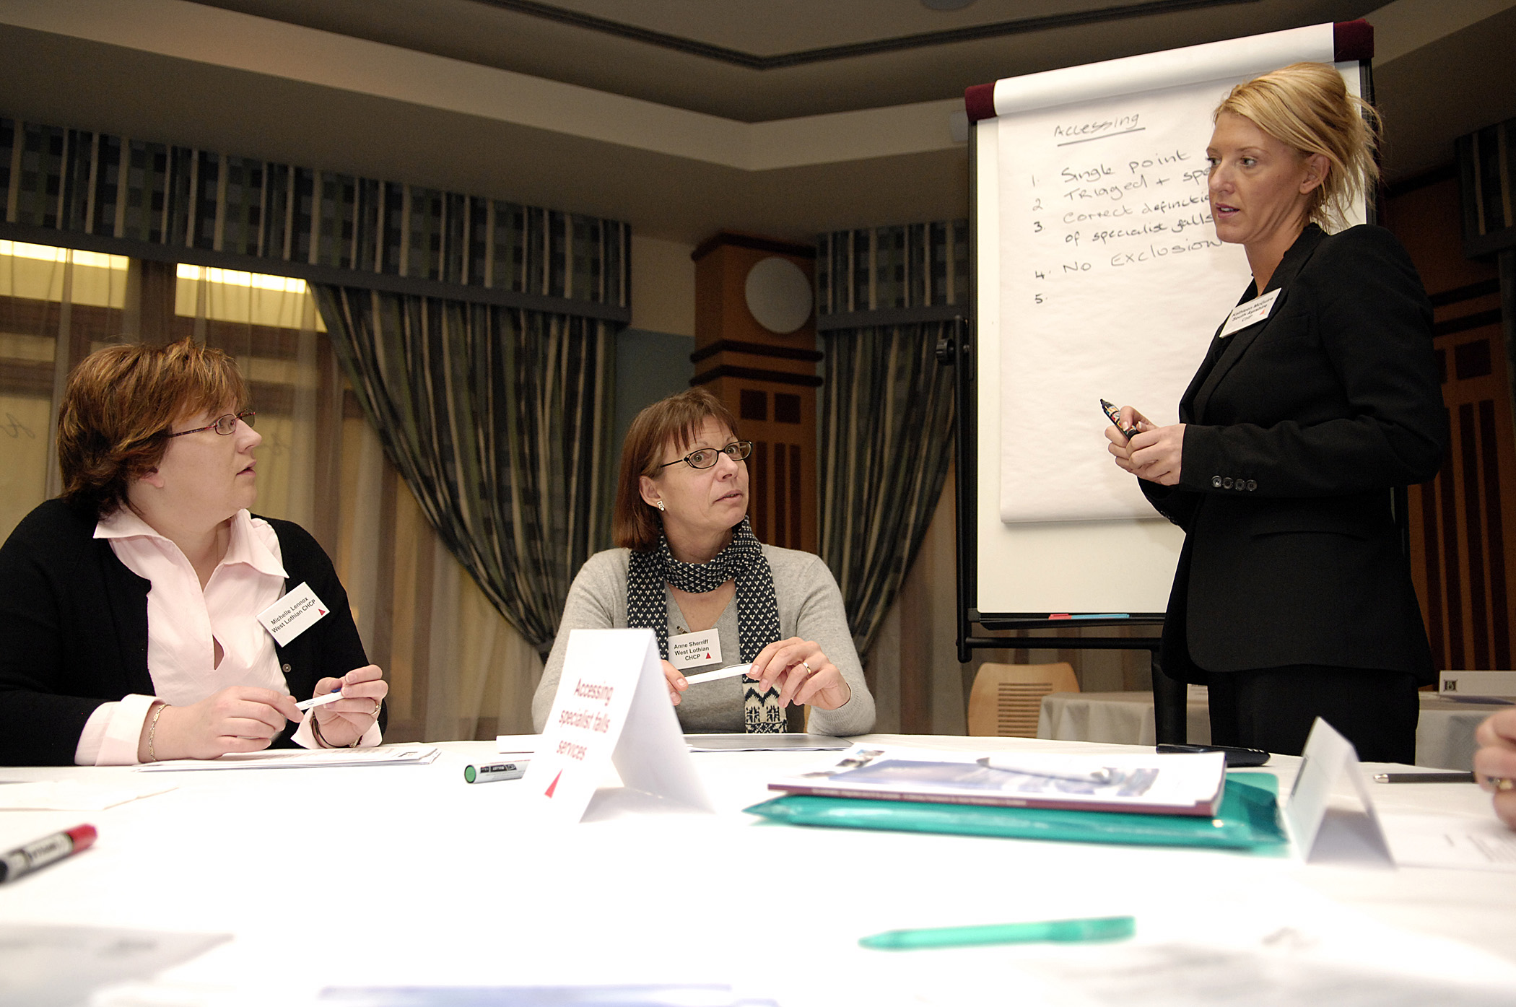
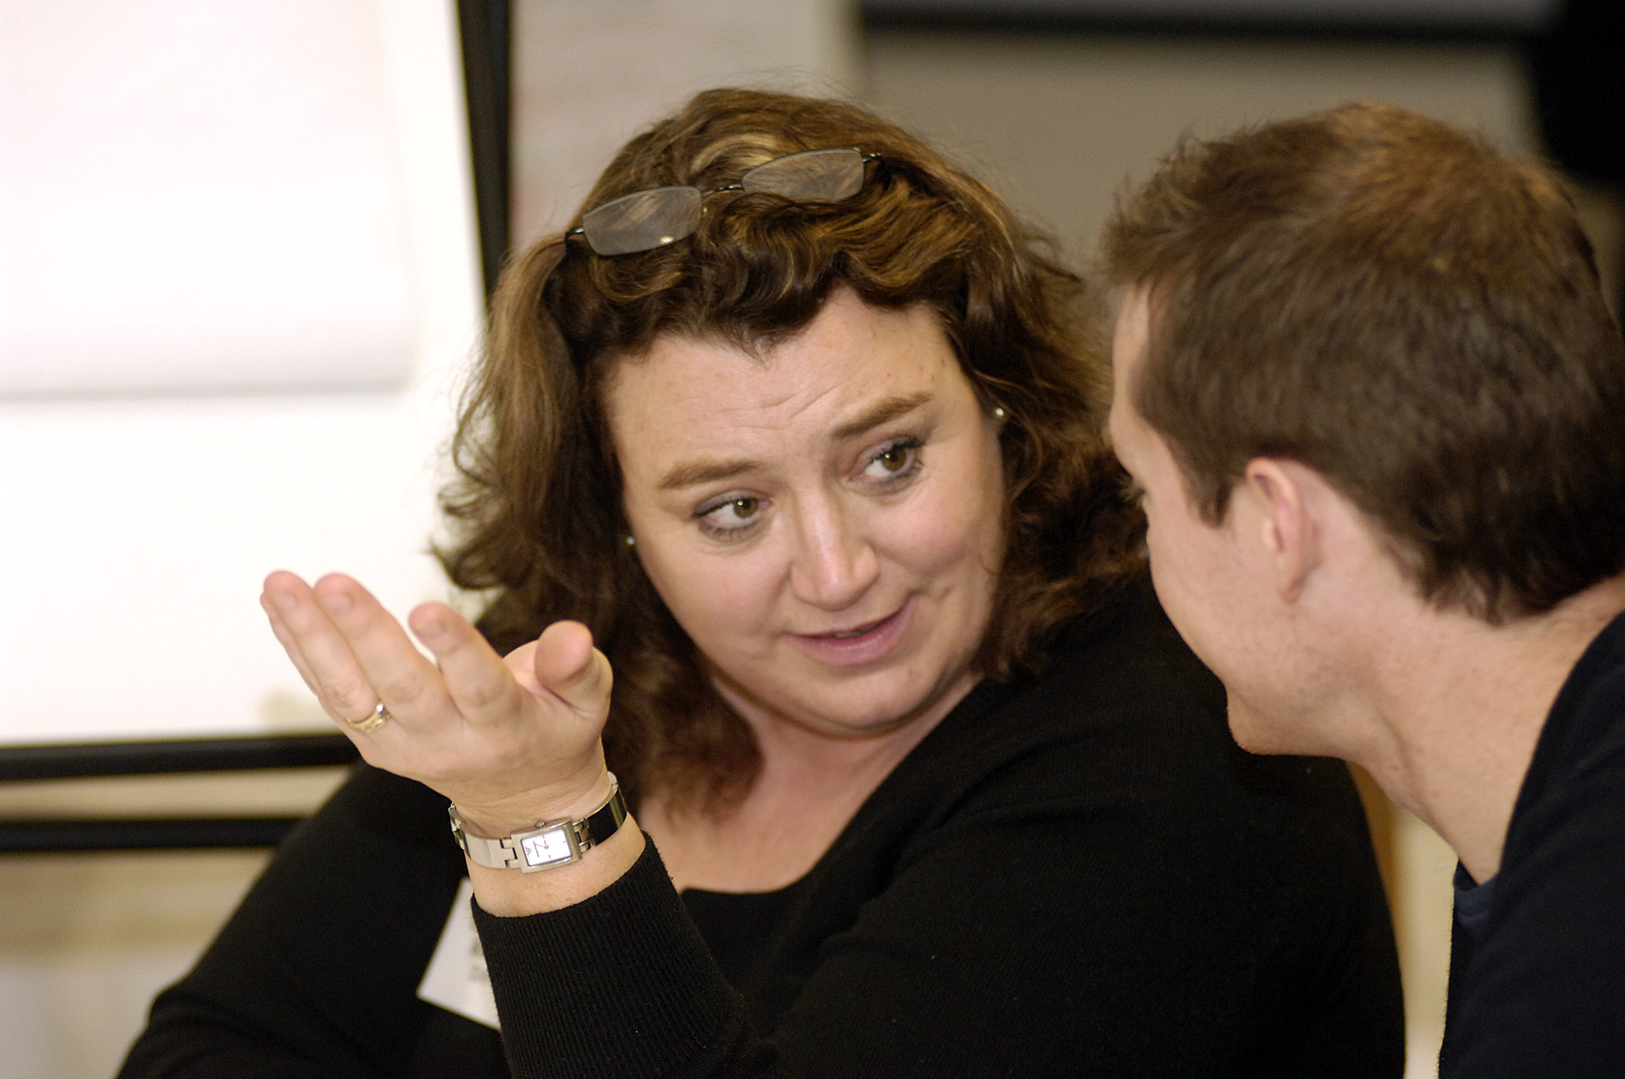
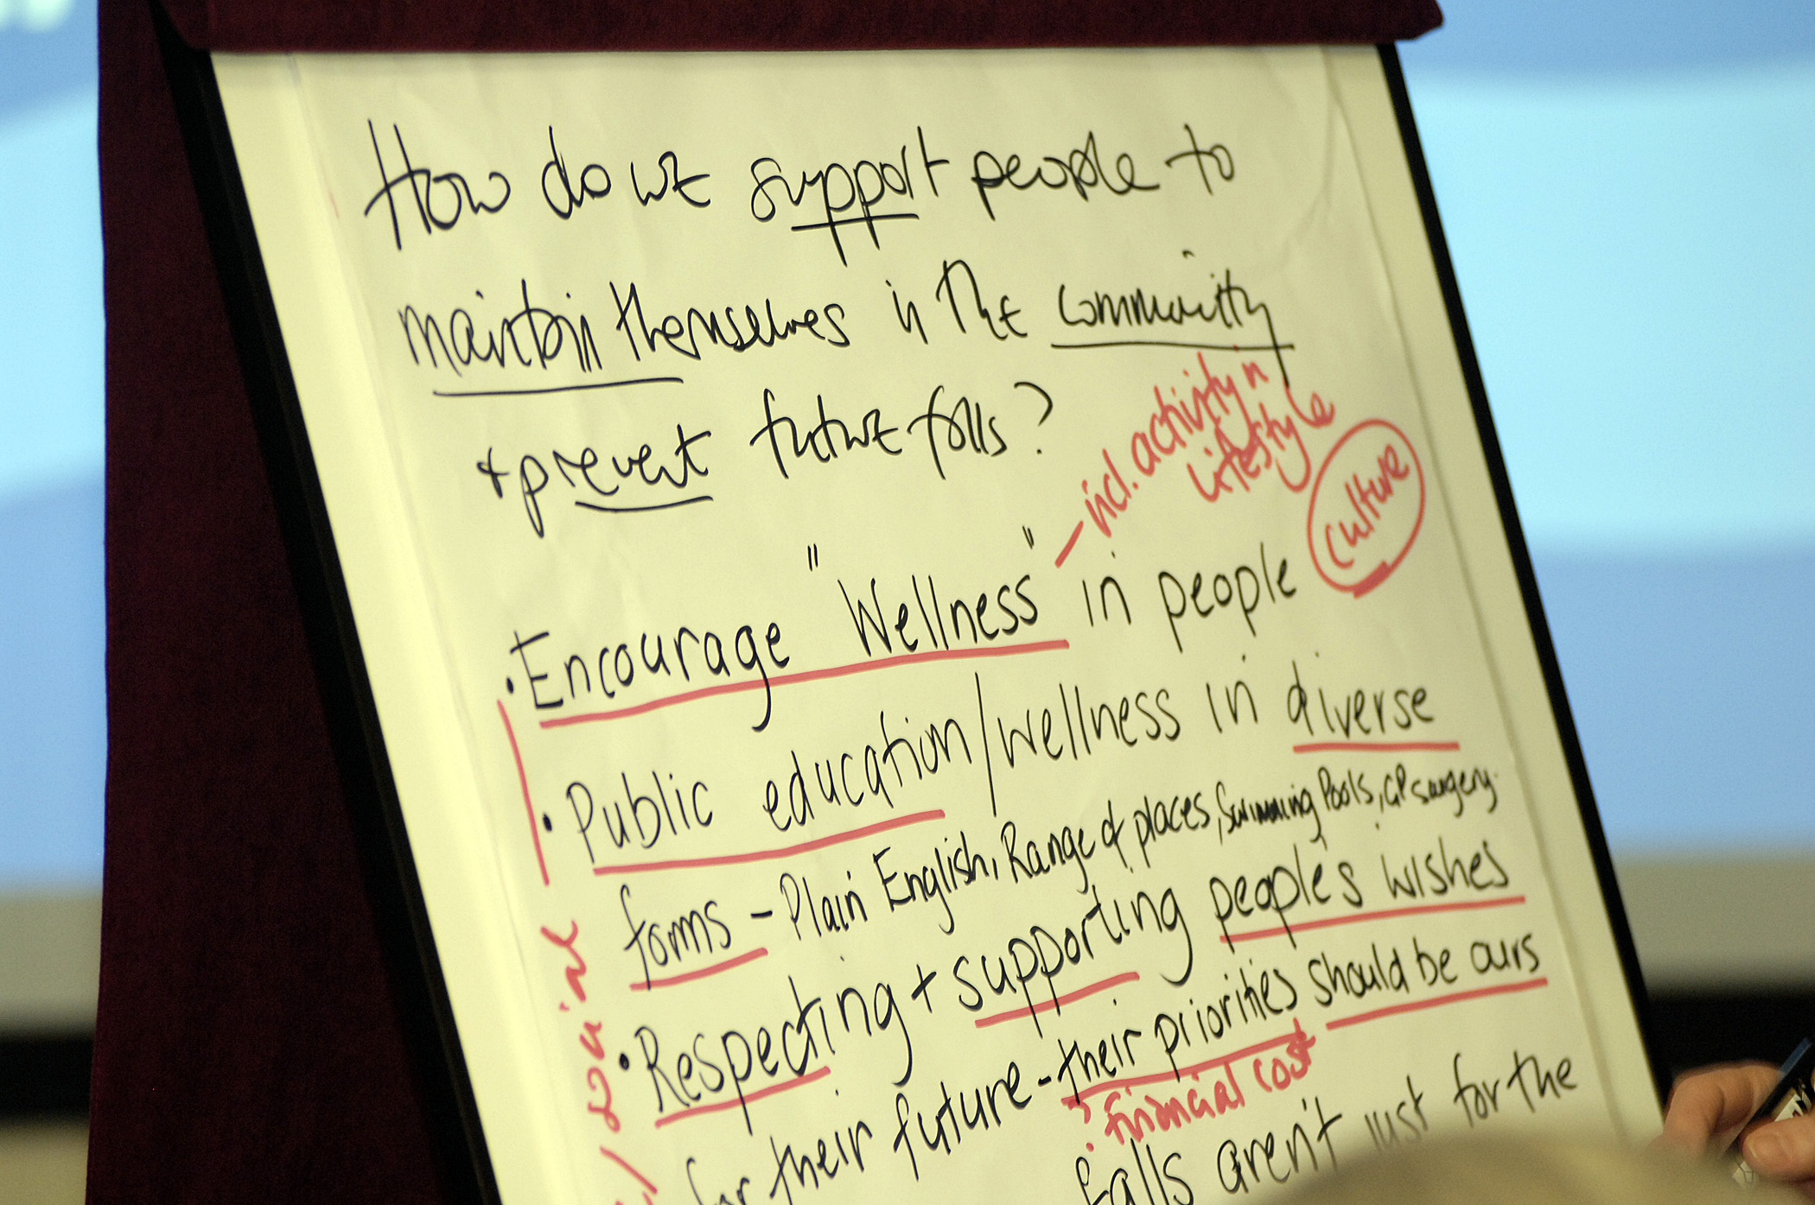
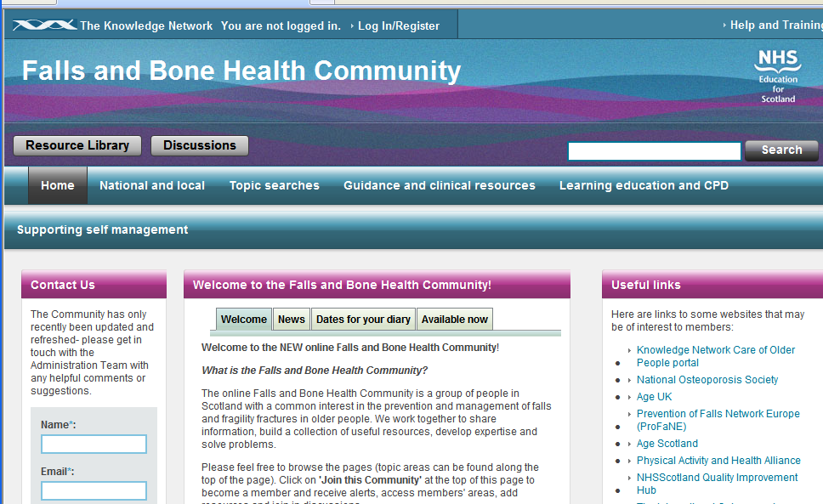
The National Falls Programme in Scotland
What are we doing?
The Falls Programme Manager in partnership with Falls Leads network and a range of stakeholders:
Co-create a shared vision.
Provide practical guidance.
Share good practice, learning and experience; provide peer support.
Identify & deliver national work streams.
  “Do once for Scotland”
Nationally and locally, make falls prevention and management part of the conversation, when it needs to be.
Monitor progress and provide accountability.

Slide 11
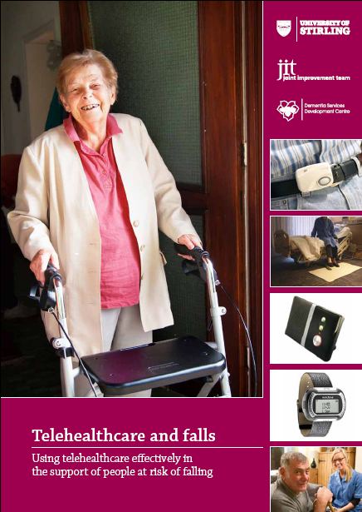
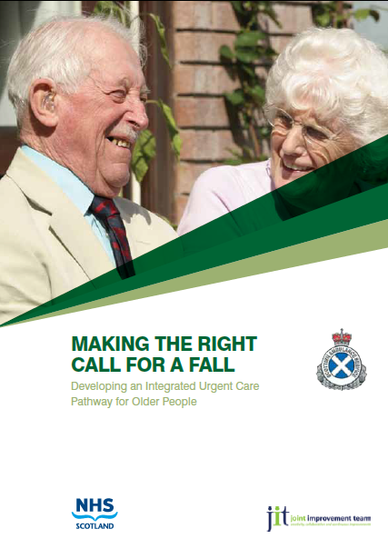
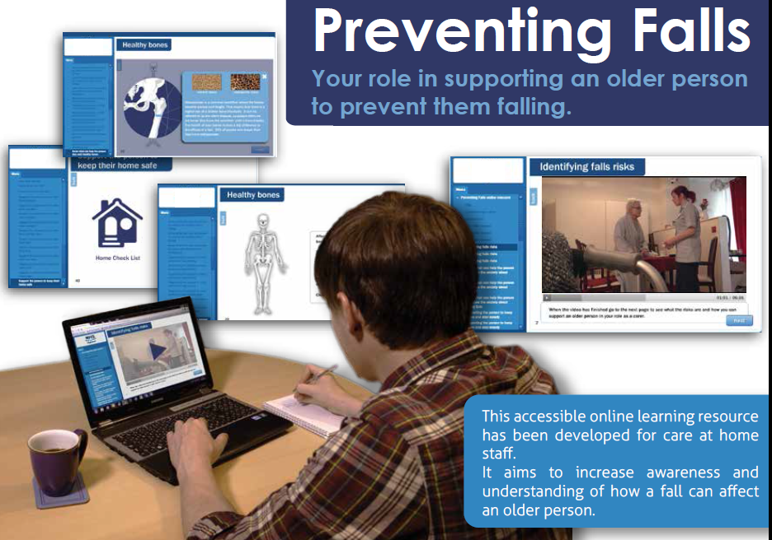
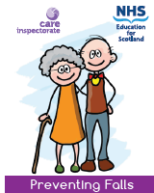

The National Falls Programme in Scotland
What are we doing?
The Falls Programme Manager in partnership with Falls Leads network and a range of stakeholders:
Co-create a shared vision.
Provide practical guidance.
Share good practice, learning and experience; provide peer support.
Identify & deliver national work streams.
  “Do once for Scotland”
Nationally and locally, make falls prevention and management part of the conversation, when it needs to be.
Monitor progress and provide accountability.

Slide 12

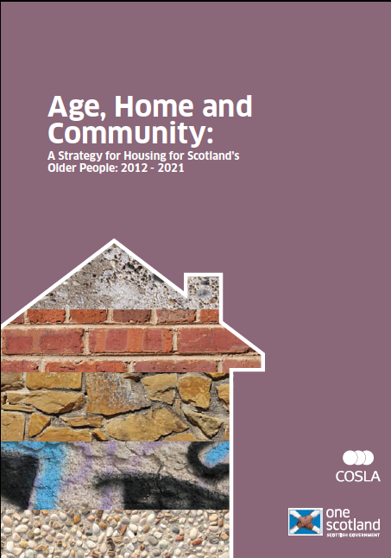


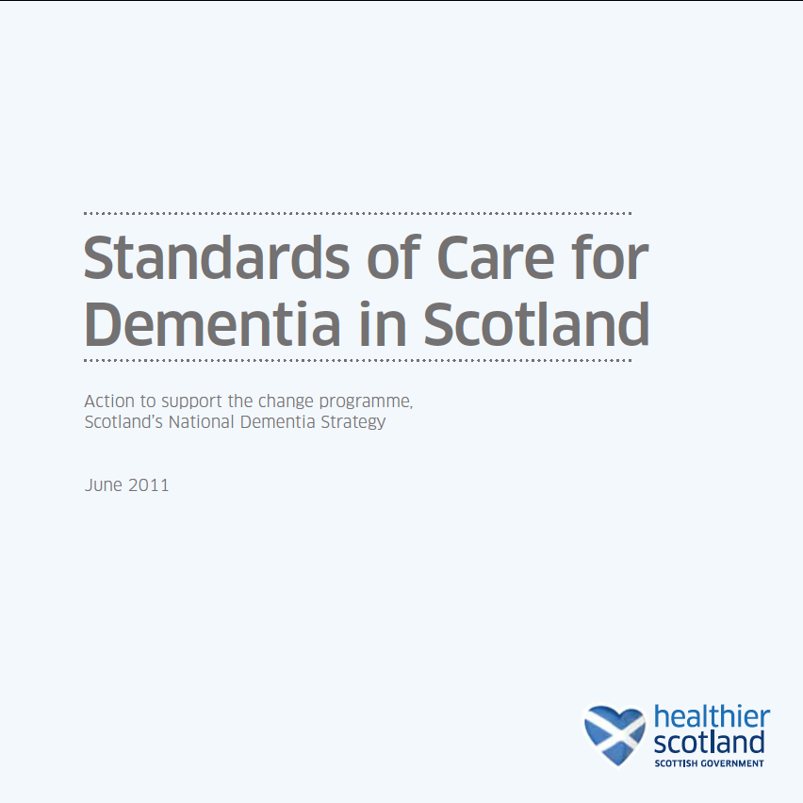
The National Falls Programme in Scotland
What are we doing?
The Falls Programme Manager in partnership with Falls Leads network and a range of stakeholders:
Co-create a shared vision.
Provide practical guidance.
Share good practice, learning and experience; provide peer support.
Identify & deliver national work streams.
  “Do once for Scotland”
Nationally and locally, make falls prevention and management part of the conversation, when it needs to be.
Monitor progress and provide accountability.
Notes:
Community, inclusive, spans…
Pre 2010 ad hoc

Slide 13
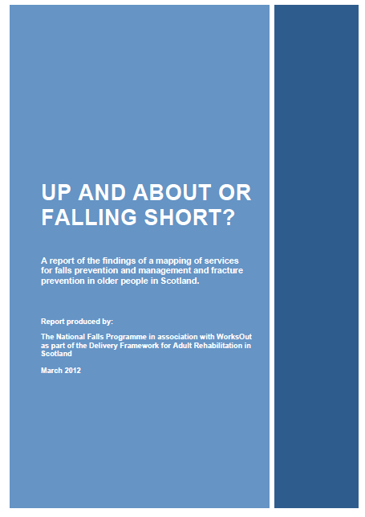
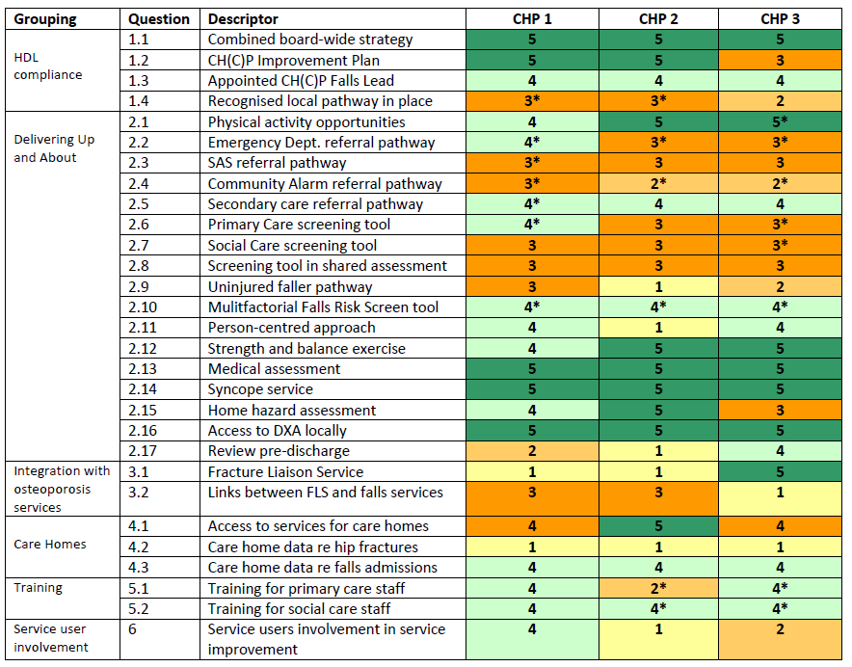
The National Falls Programme in Scotland
What are we doing?
The Falls Programme Manager in partnership with Falls Leads network and a range of stakeholders:
Co-create a shared vision.
Provide practical guidance.
Share good practice, learning and experience; provide peer support.
Identify & deliver national work streams.
  “Do once for Scotland”
Nationally and locally, make falls prevention and management part of the conversation, when it needs to be.
Monitor progress and provide accountability.
Notes:
Community, inclusive, spans…
Pre 2010 ad hoc

Slide 14

Falls Prevention and Management in Scotland
Impact
Is there a pathway for falls and fracture prevention and management in operation in your CH(C)P?
 | YES | WiP | No
2010 | 9 (24%) | 24 (63%) | 5 (13%)
2012 | 22 (58%) | 16 (42%) | -
Measurement Framework
Includes:
Scottish Ambulance Service presentations
Scottish Ambulance Service conveyances to hospital
Emergency admissions following a fall
Emergency bed days following a fall
Admissions with hip fracture
Stories:
Service users
Service providers
Notes:
Community, inclusive, spans…
Pre 2010 ad hoc
We will aim to reduce rates of emergency bed days used by those aged 75+ by a minimum of 20% by 2021 and at least 12% by 2014/15. Since 2009/10 the emergency admissions bed days rate for the over 75s has fallen markedly, as was intended: the most recent figures for 2011/12 are an estimated 5027 per 1000 bed days compared with 5393 per 1000 in 2009/10 - a 6.8% reduction.2 Although current performance varies by individual Health Board, overall performance is on trajectory to meet the target of at least 12% reduction in the rate for Scotland between 2009/10 and 2014/15.

Slide 15
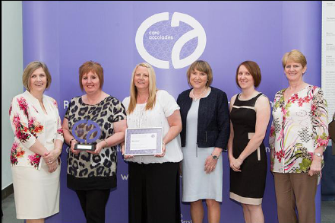
Preventing falls in the community
Falkirk Council and NHS Forth Valley (2002-present)
Timely response; information & advice; risk identification; co-ordinate tailored multi-agency intervention.
Falls avoided in the first 10 years modestly estimated at 1,733.
Estimated costs avoided £3 million.
Cost of providing the falls prevention intervention is £128,360.
Highly cost effective approach.
“This service saved my life.”
SSSC Care Accolade
‘Working better working together’ Award Winners
2013

Slide 16
Key messages
Falls prevention is everybody’s business
Be aware of the Up and About Pathway and the Framework for Action.
Recognise your role and contribution.
Communicate, co-operate and co-ordinate to build local pathways. (Do you know your local Falls Lead?)
Keep the person at risk at the centre of your pathway.
http://www.knowledge.scot.nhs.uk/fallsandbonehealth/the-national-falls-programme.aspx

Slide 17
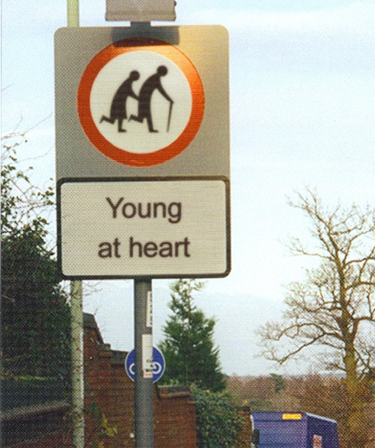
For more information, please contact:
Ann Murray
National Falls Programme Manager
ann.murray3@nhs.net
http://www.knowledge.scot.nhs.uk/fallsandbonehealth/the-national-falls-programme.aspx

